Slide 1
World War I
(1914-1918)

Slide 2
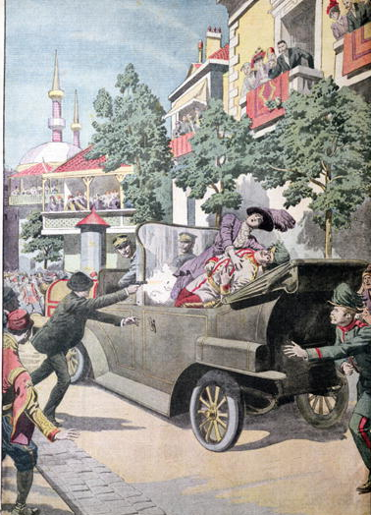
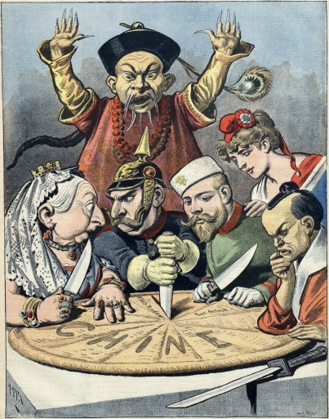
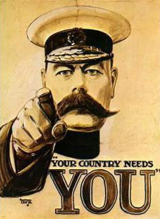
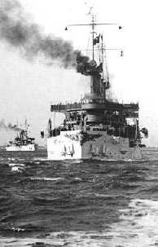
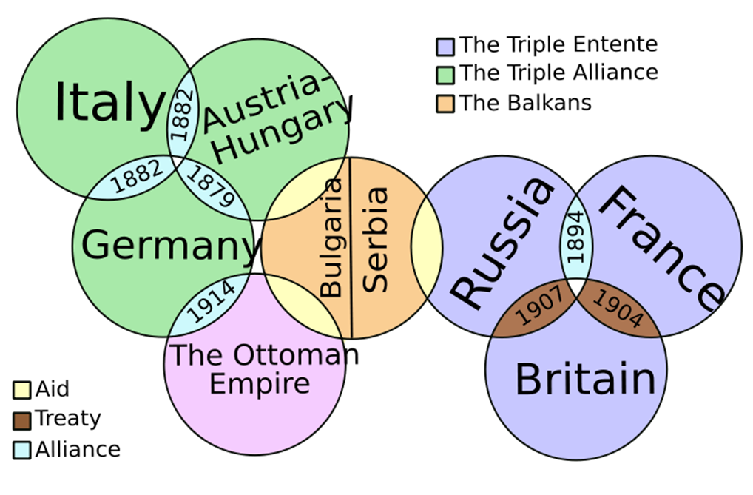
Nationalism | Imperialism | Militarism | Alliances | Assassination
Devotion to one’s nation; Encouraged competitiveness among nations; made various ethnic groups want to establish independent nations | European nations competed for resources and markets especially as Germany quickly industrialized | The need to boost national pride and protect empires led to military build-ups and a naval arms race. If one nation builds up its military, then all others must do so as well | Committed nations to support one another if attacked. 1882: | Archduke Ferdinand & wife assassinated by Bosnian nationalist Austria demanded that Serbia, who had supposedly supported the assassins, turn over anyone who was involved in the plot. Serbia refused, which led Austria-Hungary to declare war on Serbia.

Slide 3
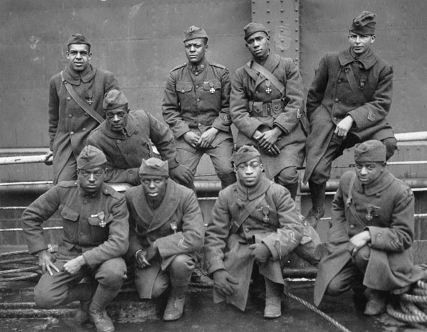
The U.S. & The War
Notes:
3

Slide 4
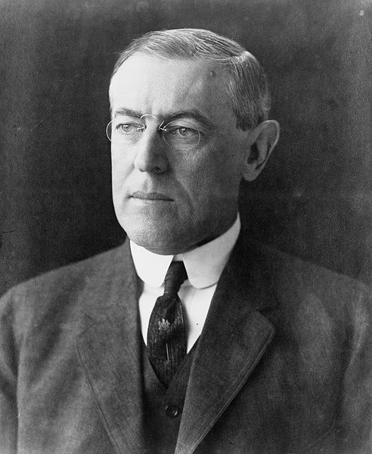
Woodrow Wilson
1856 – 1924
28th President (1913 – 21)
A pacifist, he supported US neutrality (taking no sides) and isolationism (avoiding foreign conflicts)
His Secretary of State, William Jennings Bryan, was also dedicated to neutrality
Notes:
4

Slide 5
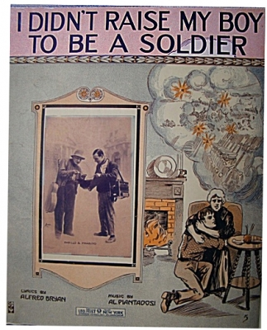
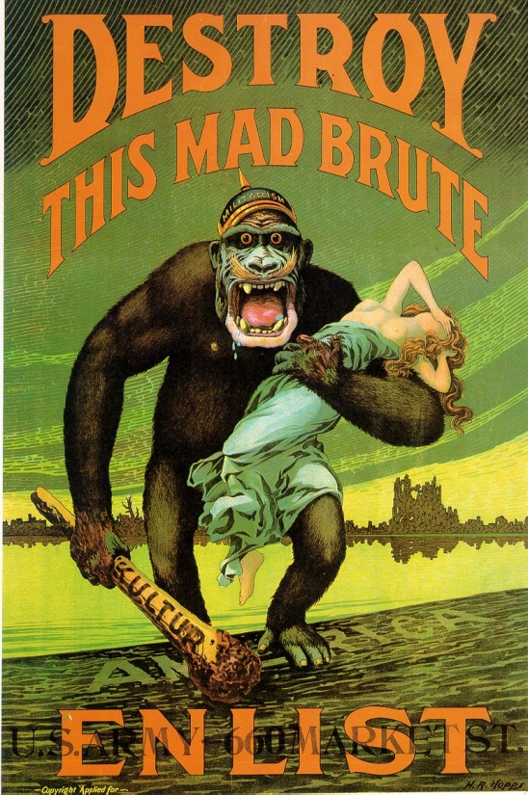
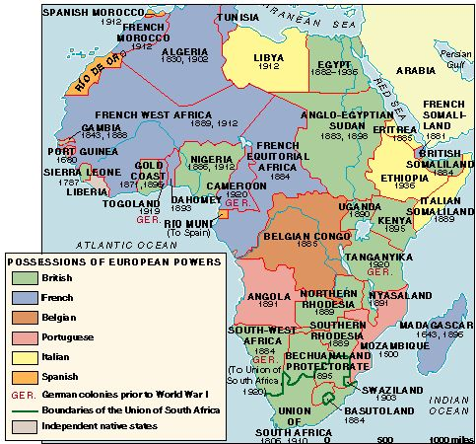
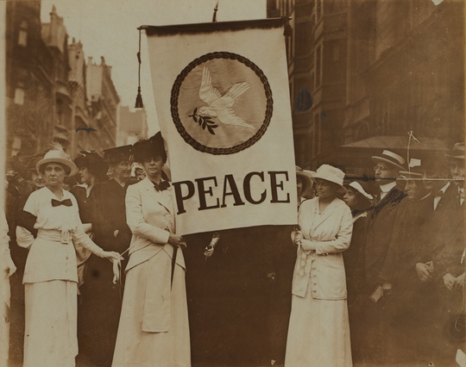
Why did the U.S. NOT get involved immediately?
Naturalized citizens | Socialists | Pacifists | Parents
Immigrants had close ties to their home nations | Saw the war as an imperialist struggle | Believed that all wars are evil ( Ex. Jeanette Rankin) | Didn’t want their sons to experience the horrors of war and die

Slide 6
Why did the U.S. enter World War I?
Read Documents A and B – both are speeches by Woodrow Wilson:
  According to the second speech, why did the U.S. enter WWI?
  How has Wilson’s attitude changed from the first speech?
  Do you trust Wilson’s speech and the reasons he gives for entering WWI?
Now use our classroom textbook (p. 584-585) and respond to the following:
  What reasons does the textbook give for why the U.S. entered the war?
  Do these reasons line up with Wilson’s reasons? Why or why not?
Finally, read the excerpt from Howard Zinn’s A People’s History of the United States. Respond to the following:
  Does Zinn agree or disagree with the textbook?
  What is Zinn’s argument? What is his evidence?
  Do you find Zinn’s argument convincing? Why or why not?
Using all the documents, what would you argue were the reasons the United States entered WWI?

Slide 7
US Enters the War
Reasons: | 1) Unrestricted Submarine Warfare & sinking of Lusitania 2) Zimmerman Note 3) Russian Revolution
Year US Entered the War | 1917
Wilson’s War Aim | Make the World a Safer Place for Democracy
Turning Point of the War | When US Entered the war

Slide 8
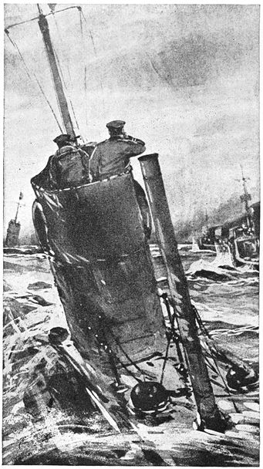
German U-boats
Germany attempted to prevent Britain & France from obtaining supplies from overseas by using submarines to attack shipping
Feb. 1915: Germany announced unrestricted submarine warfare in the waters around Britain – any ships could be attacked without warning

Slide 9
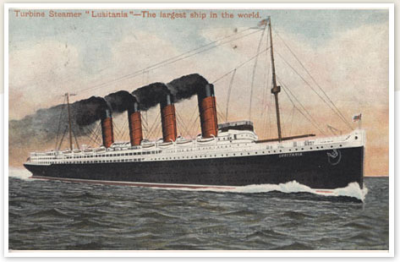
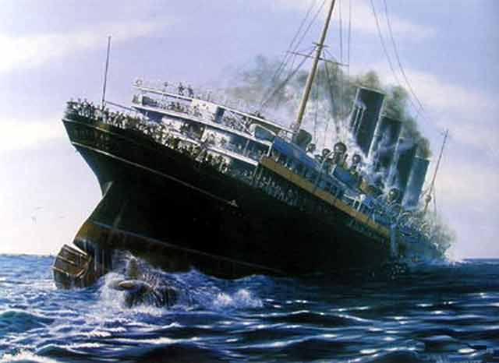
The Lusitania
May 7, 1916: German U-boat attacked and sank the British passenger liner Lusitania, killing nearly 1200 civilians, including 128 Americans
Wilson responded by warning Germany that it had a responsibility to protect non-combatants or risk war with the US

Slide 10
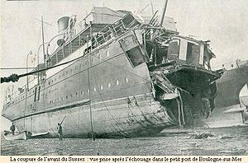
The Sussex Pledge
After a 2nd attack in March 1916 that injured Americans aboard the French ship Sussex, Wilson issued a sterner warning to Germany
Germany did not want the US to enter the war, so they promised to stop attacking merchant ships without warning
Wilson, who did not really want to enter the war, used the so-called Sussex Pledge as a political tool for getting re-elected

Slide 11
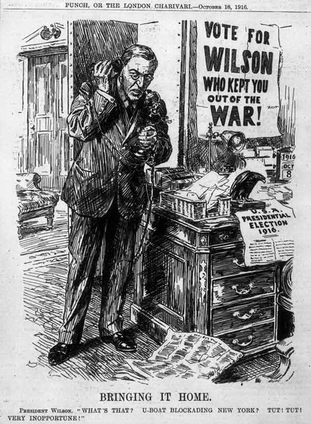
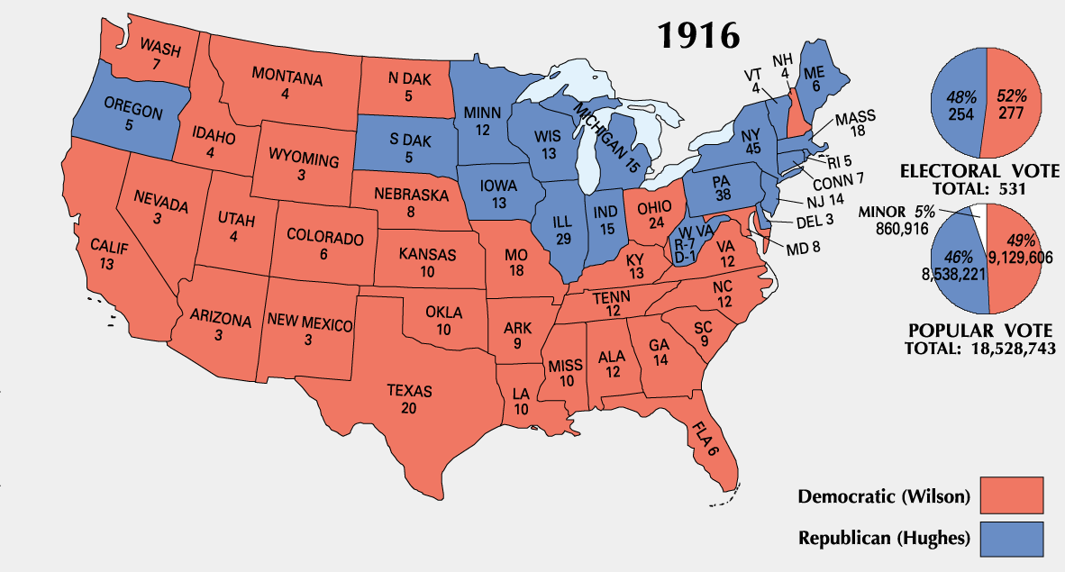
Election of 1916
Wilson won re-election on the slogan “He kept us out of war!”
He narrowly wins and calls for:
  a “peace among equals” and a “league of peace”
Isolationists’ numbers were dwindling though as the war in Europe grew more intense and US interests were threatened

Slide 12
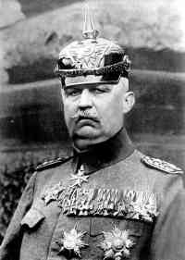
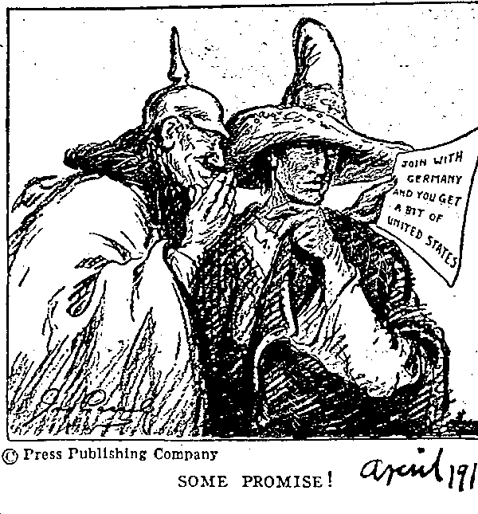
The Zimmermann Telegram
January 1917: German Foreign Minister Arthur Zimmermann sent orders to the German ambassador in Mexico to offer Mexico an alliance with Germany
Germany would help Mexico reclaim Texas, California, and the Southwest if Mexico could keep the US occupied and out of the war in Europe
Zimmermann’s note was intercepted by the British and published in US newspapers
Most Americans were enraged and began to demand war
Notes:
12

Slide 13
Russian Revolution
Created a situation in which the war became democracy versus dictatorships
4. Bolshevik Revolution occurs. Vladimir Lenin gains power and pulls Russia out of the war.
Effects of WWI on Russia: lack of food and supplies, high casualty rate, inflation which lead to riots, strikes, and mass protest
2. Overthrew the czar and established a representative government
Notes:
13

Slide 14
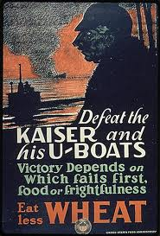
Germany’s New Plan
Germany decided they needed to end the war before the US could mobilize
Feb. 1, 1917: resumed unrestricted submarine warfare in the hopes they could force a quick British surrender
Began to attack US merchant ships without warning, prompting Wilson to take action

Slide 15
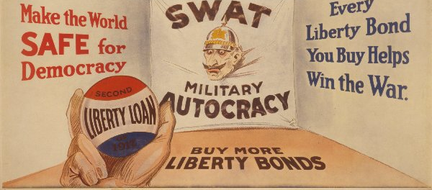
Wilson Asks for War
President Wilson asked Congress for a formal declaration of war on April 2, 1917
Germany
The Senate approved war by a vote of 82 to 6, the House by a vote of 373 to 50
Ultimate cause? – to protect “neutral rights”
  Wilson: war to “make the world safe for democracy”

Slide 16
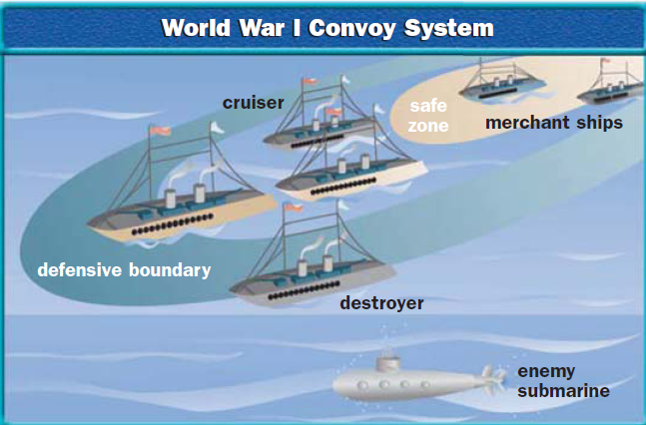
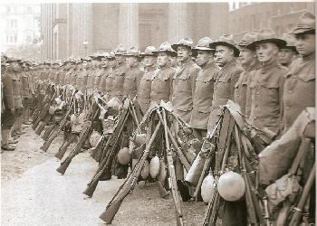
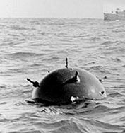
America Tips the Balance
How did the U.S. raise an army? | How did U.S. soldiers help win the war?
Called for volunteers; Instituted a draft (Selective Service Act) | Brought fresh troops and enthusiasm (war was three years old!) Helped stop the German advance toward Paris (Battle of the Marne) Helped Allies become offensive
How did the U.S. build its naval force? | How did the U.S. Navy help win the war?
Accepted women volunteers; Exempted shipyard workers from the draft; Advertised shipyard work; Took over commercial and private ships and converted them to war ships | Broke the German blockade with the convoy system; Helped lay down a barrier of mines in the North Sea

Slide 17
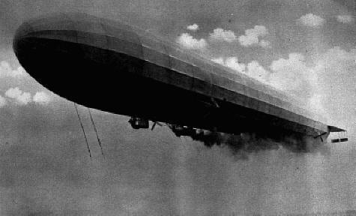
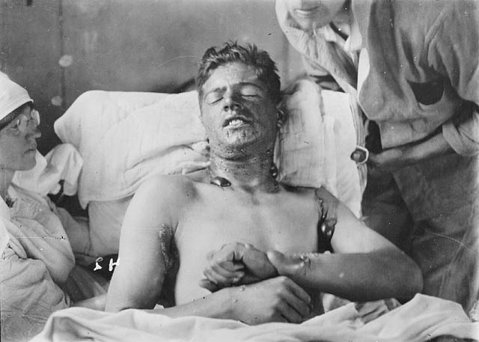
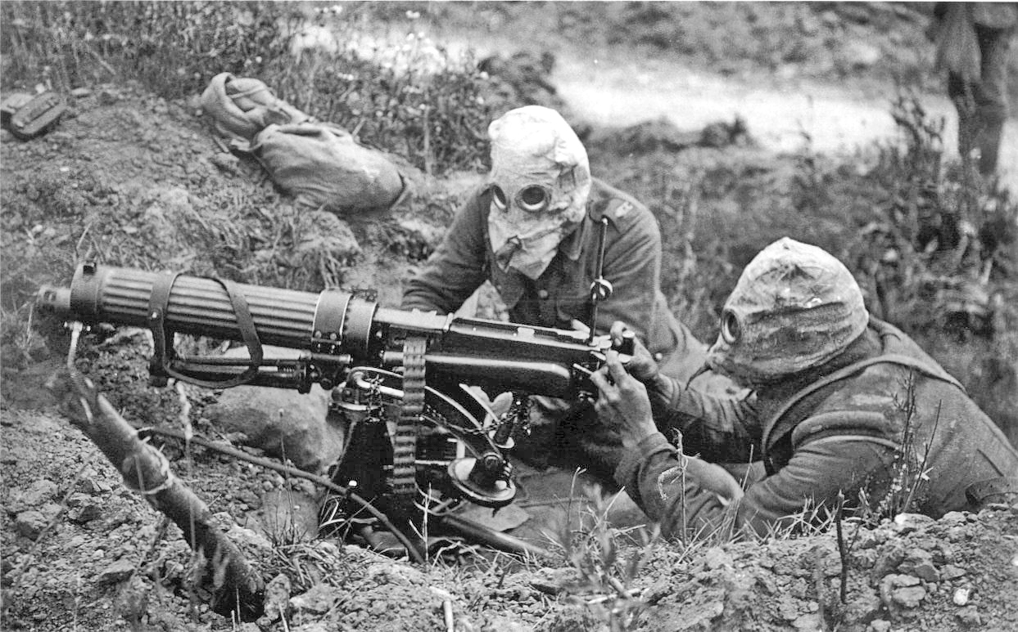
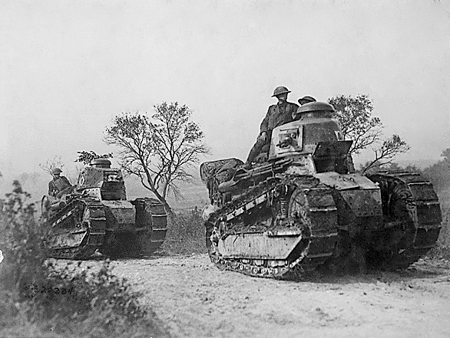
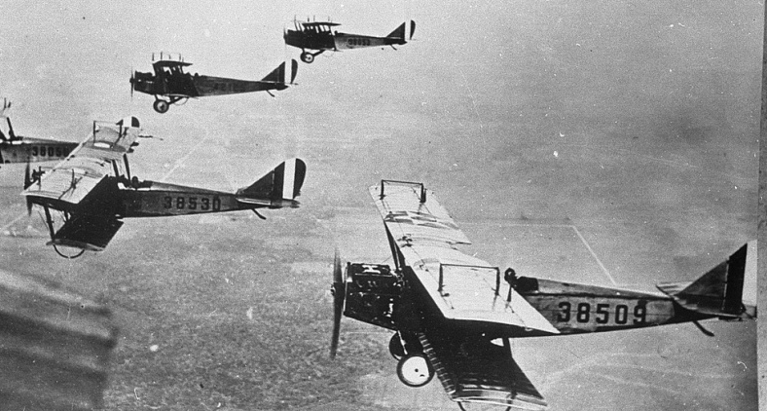
New Technology in WWI
What new weapons of mechanized warfare threatened those in combat?
Zeppelins (gas-filled airships) Machine guns Poison gas Tanks Airplanes

Slide 18
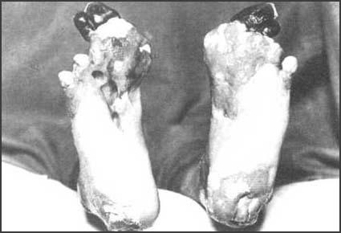
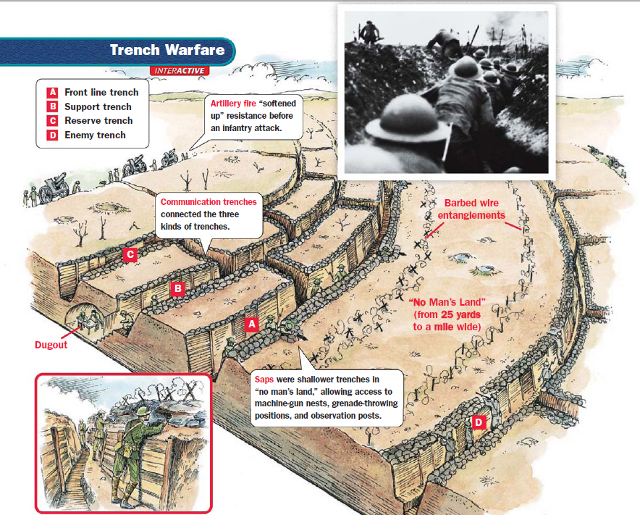
Life in the Trenches

Slide 19
Life in the Trenches

Slide 20
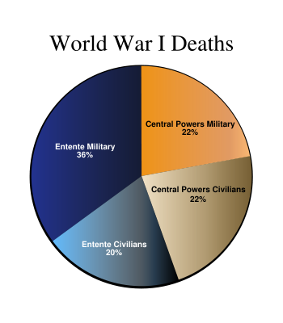
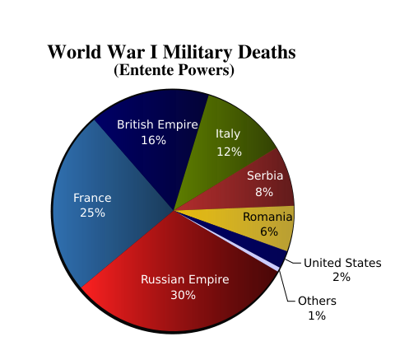
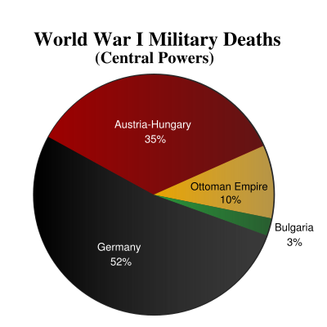
Costs of World War I
What did the war cost in terms of the number of…
civilian deaths? | military deaths? | injuries? | refugees?
More than 11 million | Around 11 million | 20 million | 10 million
Economic Costs?
$338 billion – who pays for that?

