Slide 1
Vietnam War Photo Analysis

Slide 2
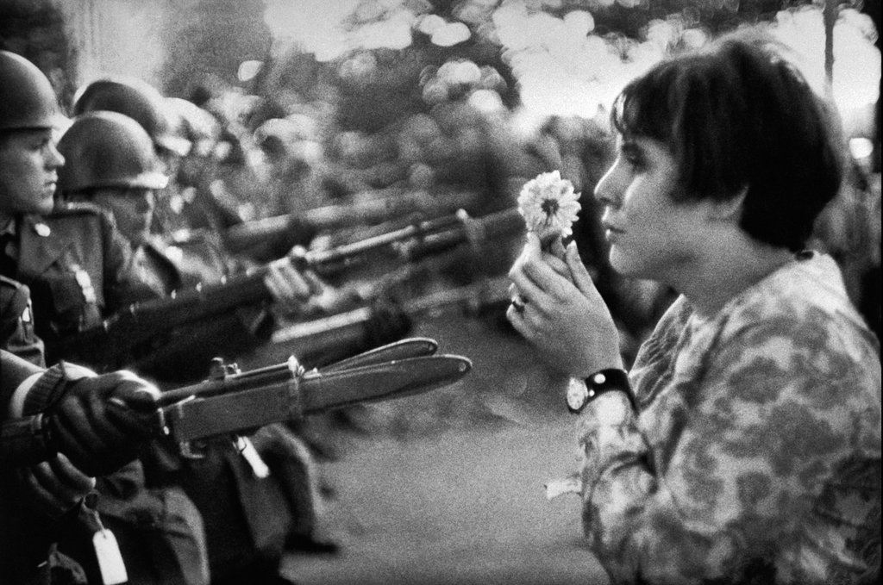
March on the Pentagon

Slide 3
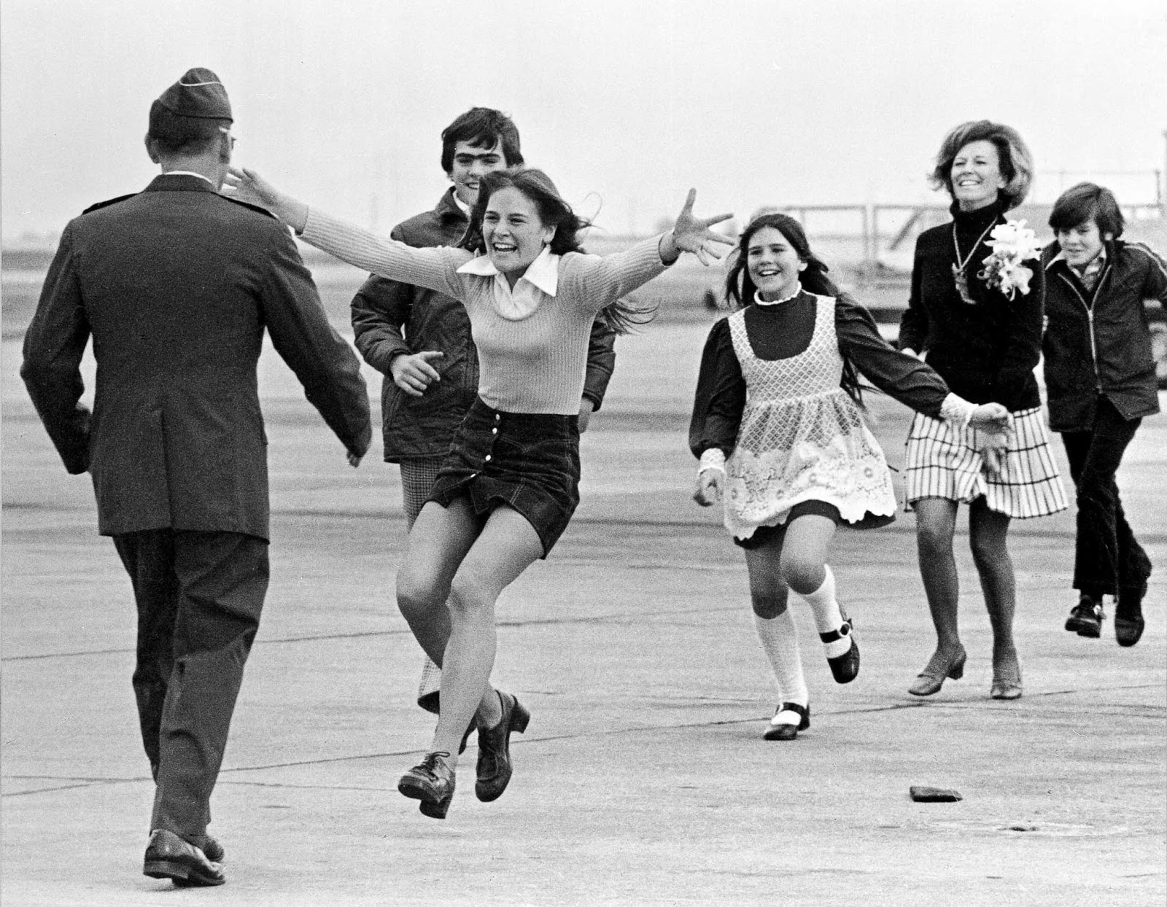
Burst of Joy

Slide 4
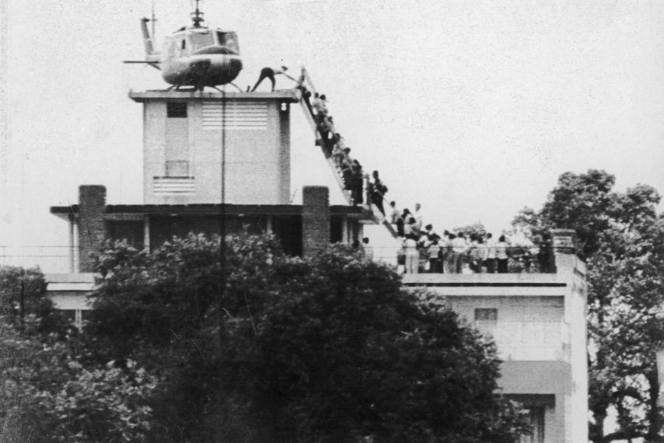
Fall of Saigon

Slide 5
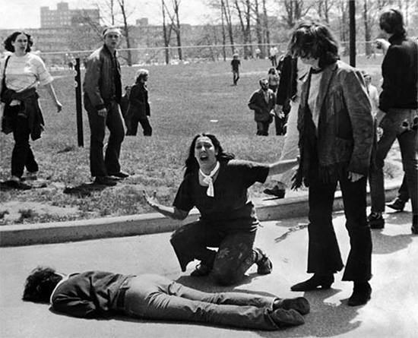
Kent State Shooting

Slide 6
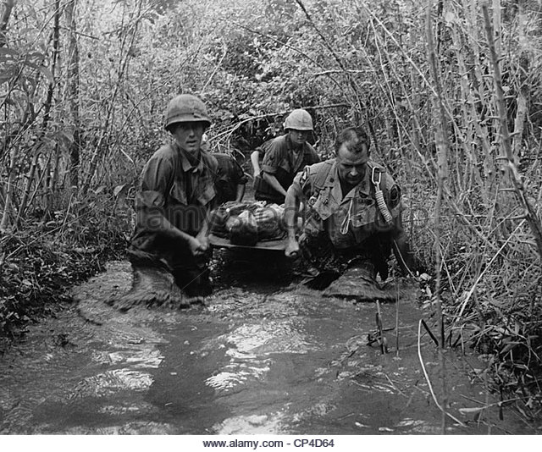
Wounded Soldier in the Jungle

Slide 7
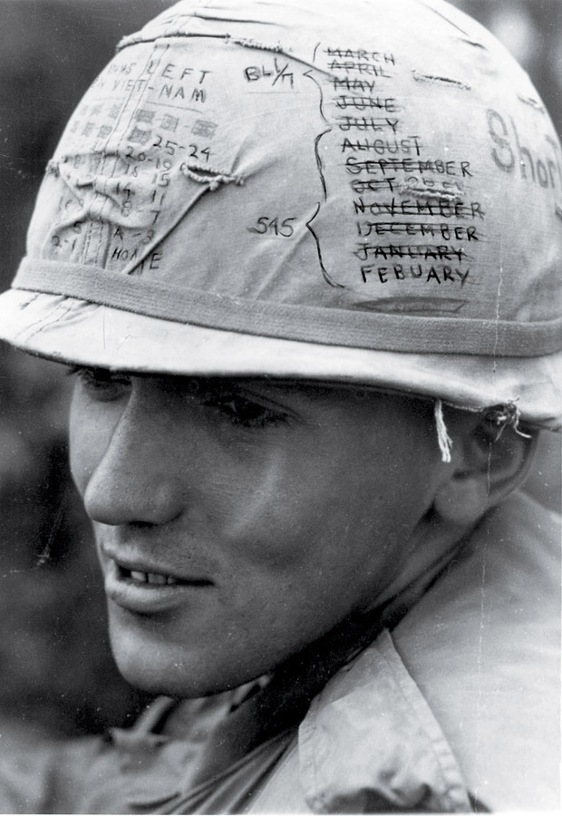
Soldier in the War

