Slide 1
The Middle & Southern Colonies

Slide 2
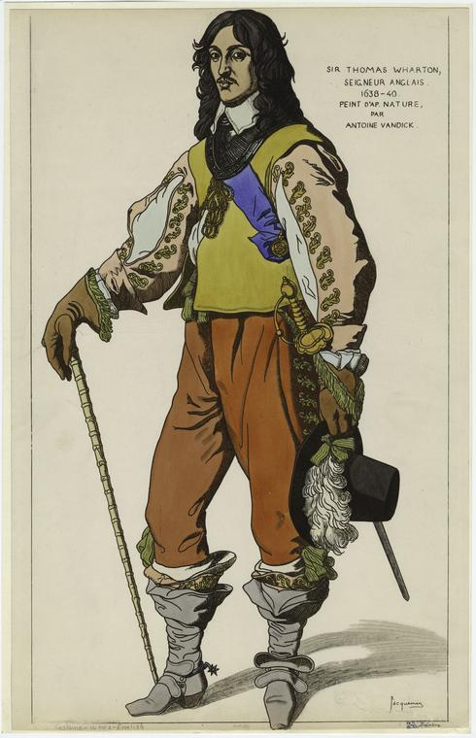
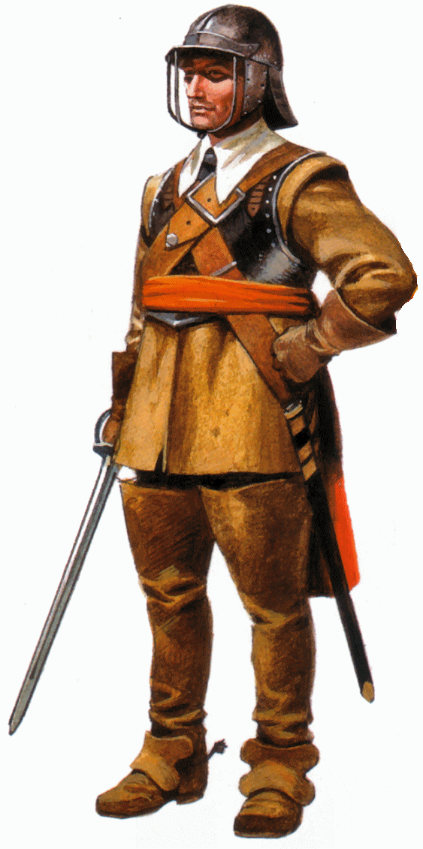
The English Civil War
In the early 1640s, war broke out in England between King Charles I and the Puritan dominated Parliament
British citizens in the Americas had to decide who to support – settlers in Virginia & Maryland supported the king, while the Puritans of New England supported Parliament
Parliament won in 1646

Slide 3
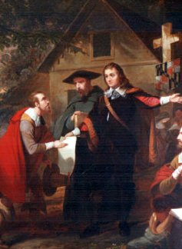
Consequences of War
Virginia was subdued by a naval force sent by Parliament
Maryland’s Catholic proprietor, Lord Baltimore, was forced to issue the Maryland Toleration Act, which granted religious freedom to all Christians, in 1649 to appease angry Protestants
In New England, population fell as some Puritans returned home to England

Slide 4
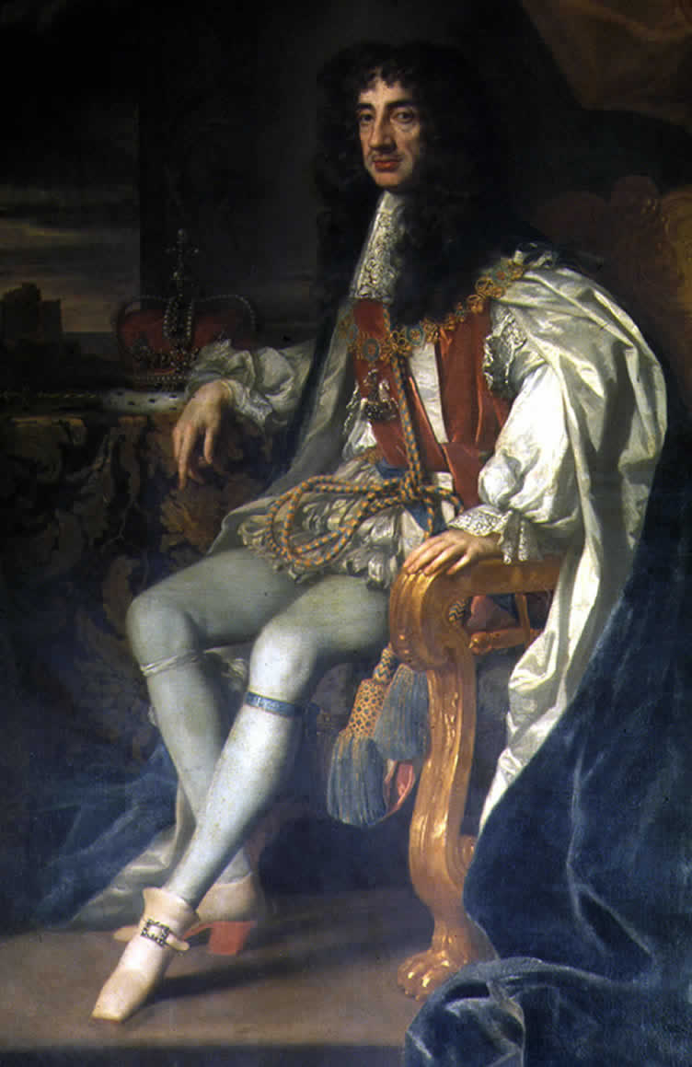
Halt of Expansion
During the period of the English Commonwealth, further colonization in America came to a halt
When the monarchy was restored in 1660, colonization resumed, this time under the direct order of the new king, Charles II

Slide 5
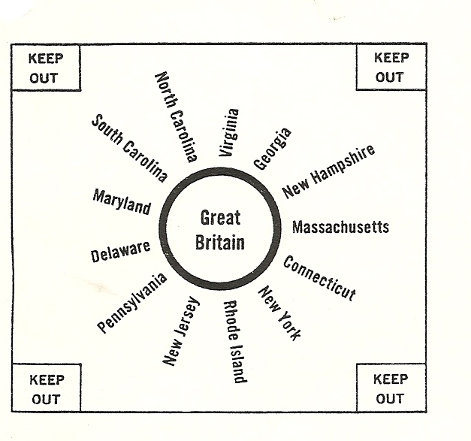
Mercantilism
With the new king came economic stability and a renewed demand for the raw materials America had to offer, as well as the desire to create new markets for English manufactured goods - mercantilism

Slide 6
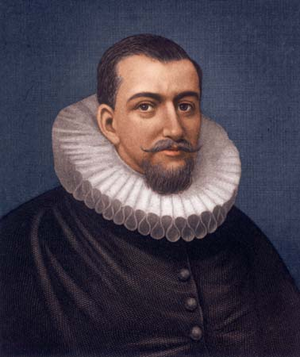
The Dutch
Explorer Henry Hudson had explored the Hudson River area for the Dutch government in 1609 and reported that the region was rich in fur-bearing animals
In 1614, the Dutch established the trading post of New Amsterdam on Manhattan Island, at the mouth of the Hudson

Slide 7
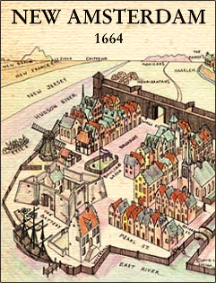
New Netherland
The Dutch colony grew very slowly, and only had a population of about 1500 by 1646
To increase the size of the colony, the Dutch opened it to settlers of any nationality
By 1664, over 10,000 settlers had arrived from all over Europe, including the first Jewish settlers to reach American soil and about 1000 African slaves

Slide 8
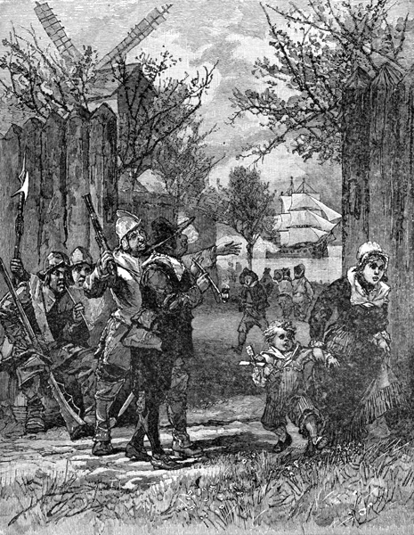
The English Response
The Dutch colony was seen as a threat by the English, as it provided a safe haven for smuggling goods in and out of the British colonies without the collection of taxes
In 1663, King Charles II declared the area to be a British possession and authorized his brother, James, the Duke of York to use military force to seize New Netherland

Slide 9
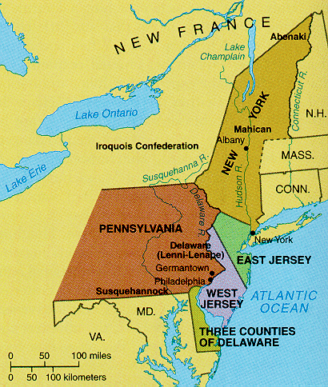
New York
Lacking sufficient defense, the town of New Amsterdam was forced to surrender to the British in 1664 and was promptly renamed New York
To reward some of his supporters, James granted a portion of New Netherland to Sir George Carteret, a region which came to be called New Jersey

Slide 10
New Jersey
To attract English settlers, Carteret and his associate Lord John Berkeley offered generous land grants, religious freedom, and the right to elect a legislative assembly
This resulted in an influx of Puritan settlers to the new colony

Slide 11
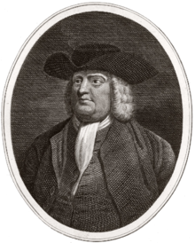
William Penn
King Charles II had gone into debt, partly to fund the military expedition to seize New York, to a supporter named Admiral William Penn.
Penn’s heir, also named William Penn, offered to settle the debt in exchange for the granting of a colony covering the gap between New Jersey and Maryland
Charles reluctantly agreed, due to concerns over Penn’s religion – he was a Quaker

Slide 12
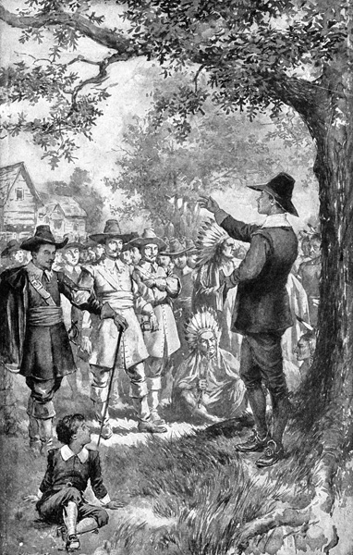
Quakers
Believe there is no need for church buildings or ministers, because everyone receives their own “inner light” from God
Object to secular authority (government) and often refuse to pay taxes
Believe in pacifism, or opposition to all violence, including war, so they do not serve in the military
The religion had been banned by King Charles, leading most Quakers to flee to America

Slide 13
Pennsylvania
Penn gave his fellow Quakers a safe haven in his newly chartered colony of Pennsylvania
Penn believed in complete political and religious freedom
He also vowed to treat the Native Americans with respect and friendship

Slide 14
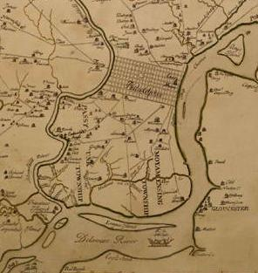
Philadelphia
After signing the Treaty of Shackamaxon with the local Native tribe, Penn established his capital at Philadelphia, “the city of brotherly love”
Penn made land readily available to attract colonists, drawing over 7000 colonists by 1684

Slide 15
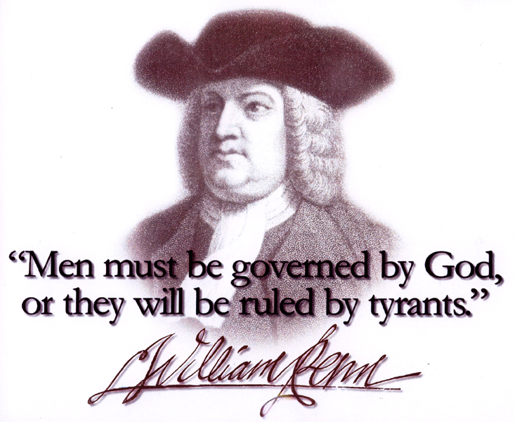
Pennsylvania’s Government
Penn established a government in which he appointed the governor, but allowed all men who owned land or paid taxes (so long as they were Christian) to vote for a legislative assembly
Non-Christians were still welcome and tolerated in Pennsylvania, but were not allowed to vote

Slide 16
Delaware
In 1682, to increase his holdings, Penn purchased the region of Delaware from the Duke of York
Initially administered as part of Pennsylvania, Delaware quickly became its own separate colony

Slide 17
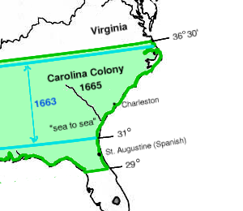
Carolina
In an effort to block Spanish expansion northward, or French expansion eastward, Charles awarded the region south of Virginia, known as “Carolina” to several of his friends and political allies in 1662

Slide 18
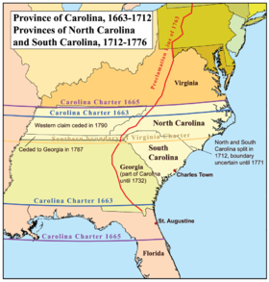
North Carolina
The colony developed slowly due to poor access from the sea (all potential harbors were blocked by the Outer Banks)
By 1700, only 3000 colonists had settled, mostly tobacco farmers who had moved down from Virginia

Slide 19
South Carolina
First settlers arrived in 1670, quickly establishing the port of Charles Town (Charleston)
Attempts were made at creating sugar cane plantations, but the climate wasn’t right
First successful exports were deerskins and Indian slaves

Slide 20
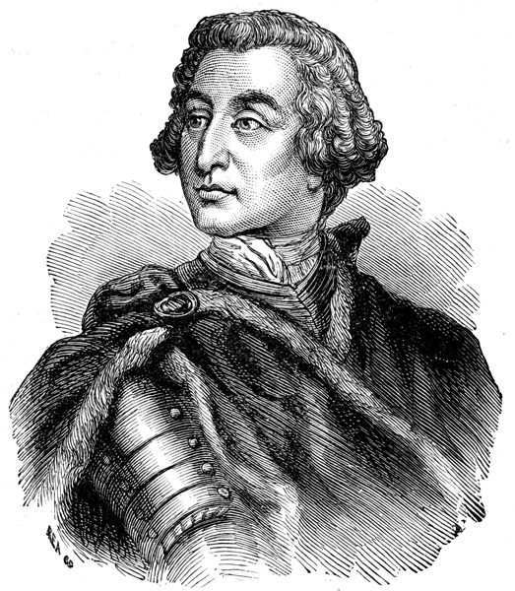
James Oglethorpe
In the 1720s, James Oglethorpe petitioned King George II for a colony south of Carolina for the purpose of resettling English poor who had been imprisoned for failure to pay their debts
George granted the request, seeing this new colony of Georgia as a way to protect English South Carolina from Spanish Florida

Slide 21
Georgia
Oglethorpe arrived at the mouth of the Savannah River with his first settlers in 1733, establishing the port of Savannah
Oglethorpe, in the interest of helping these poor debtors start a new life free of the sins of their past, banned rum, brandy, and slavery in the colony and limited plantations to 500 acres
The bans, however, were unpopular and did not last into the 1740s

