Slide 1
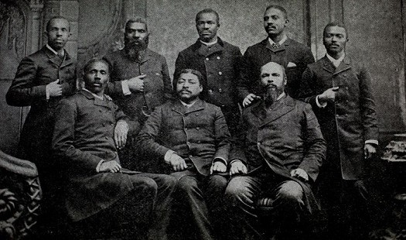
African American Politicans during Recontruction Storybook

Slide 2
Page 1
Give the reader information about this person’s childhood and early life
Pictures, etc..

Slide 3
Page 2
Give the reader information about what this person did during and after the Civil War
Pictures, etc..
Oh ! this is great.

Slide 4
Page 3
Give the reader information about what political office or what offices this person held as well as what they did to try to help their states or people
Pictures, etc..

Slide 5
Page 4
Continue telling the readers about what this person did while in office.
Give the reader information about what this person did towards the end of their life.
Pictures, etc..

Slide 6
THANKS!
Any questions?
You can find me at @username & user@mail.me

