Slide 1
Socialization
Part I

Slide 2
Do Now: How have your parents/guardians made you who you are today? Give examples of your baby/childhood experiences with parents/guardians that have shaped you into the person you are. Discuss with a partner.

Slide 3
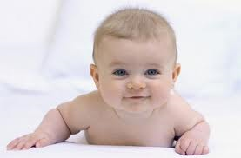
Socialization is…
Socialization: the cultural process of learning to participate in group life.
Begins at birth and continues throughout life

Slide 4
Harry Harlow’s Monkey Experiment
Psychologist, Harry Harlow, devised a famous experiment that showed the negative effects of social isolation on rhesus monkeys.
In one experiment, infant monkeys, separated from their mothers at birth, were exposed to 2 artificial mothers—wire dummies of the same appropriate size and shape as real adult monkeys. One of the substitute monkeys had an exposed wire body. The other was covered with soft terry cloth. Free to choose b/t them, the infant monkeys consistently spent more time with the soft, warm mother. … apparently, the closeness and comfort were more important to these monkeys than food… when frightened, the infant monkeys consistently ran to their terry cloth mothers for security and protection

Slide 5
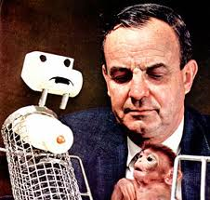
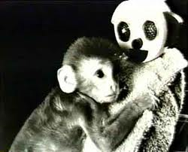

Slide 6
Harry Harlow’s Monkey Experiment
Harlow’s experiments showed that infant monkeys need intimacy, warmth, physical contact, and comfort. Infant monkeys raised in isolation became distressed, apathetic, withdrawn, hostile adult animals. They never exhibited normal sexual patterns. As mothers, they either rejected or ignored their babies, and sometimes even physically abused them.
Many experts on human development believe that for human infants (like Harlow’s monkeys) emotional needs for affection, intimacy, and warmth are as important as physiological needs for food, water, and protection. Human babies denied close contact usually have difficulty forming emotional ties with others.

Slide 7
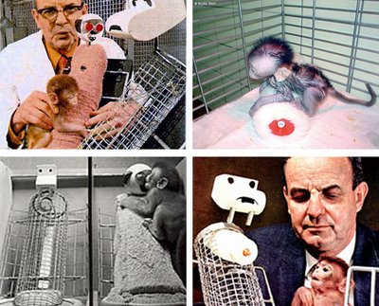

Slide 8
Functionalism: Socialization
Functionalism stresses the way in which groups work together to create a stable society.
Schools and families socialize children by teaching them the same basic norms, beliefs, and values the teachers and parents were once taught.

Slide 10
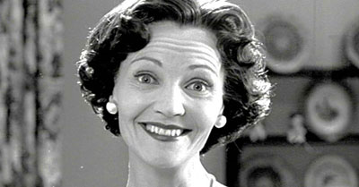

Slide 11
Conflict Theory: Socialization
The conflict perspective views socialization as a way of perpetuating the status quo.
When people are socialized to accept their family’s social class, they help preserve the current class system.

Slide 12
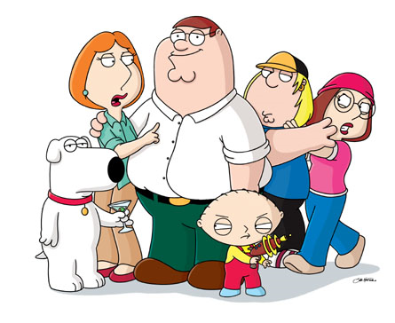

Slide 13
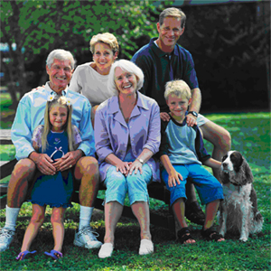

Slide 15
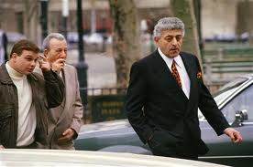

Slide 16
Conflict Theory: Socialization
People learn to accept their social status before they have enough self-awareness to realize what is happening.
Many people do not challenge their position in life, thus they do not upset the existing class structure.
Consequently, socialization maintains the social, political, and economic advantages of the higher social classes.

Slide 17
Monday, November 21st, 2017
EQ- What are the key concepts of socialization from a symbolic interactionist perspective?
Journal Log- Answer the following inside your journal log:
“Why do our parents let us watch tv if most parents agree that they don’t like the effects of tv on children?” Then Discuss with person beside you.
Agenda: 1) Journal Log 2) Notes & Video 3) Looking-Glass Assignment 4) Goal Sheet Time

Slide 18
Symbolic Interaction: Socialization
Symbolic interaction uses a number of key concepts to explain socialization.
I. The Self Concept
II. The Looking Glass Self
III. Significant Others
IV. The Generalized Other
V. Role Taking

Slide 19
SI: The Self Concept
The self-concept: an image of yourself as having an identity separate from other people

Slide 20
SI: The Looking Glass Self
The looking-glass self: an image of yourself based on what you believe others think of you
What are the steps in this process?
1. Imagine how we want to appear to other.
2. Looking at how other react to our actions.
3. We react to our assumptions of how people judge/perceives us.
The looking-glass self can be distorted!
It comes from our imagination, the mirror may not accurately reflect others’ opinions of us

Slide 21
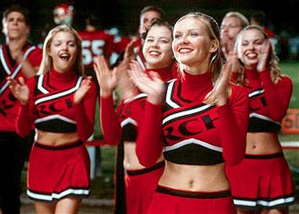
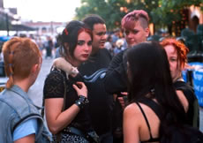
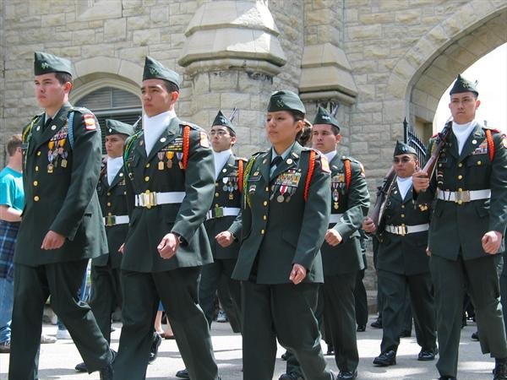
The Looking Glass Self in Action
Teenagers are often strongly influenced by their peers and will go beyond conforming to changing their self-image to match.
Using it
If you want someone to believe something about themselves, act towards them as if it were true.

Slide 22
SI: Significant Others
Significant others: those people whose reactions are most important to your self-concept
For a child significant others include parents, grandparents, teachers, and playmates.
For teenagers, significant others mainly include their friends/peers.
For adults, significant others range from spouses, parents, and friends, to ministers and employers.

Slide 23
Think-Pair-Share
“ No one can make you feel inferior without your consent”
How is this statement an example of the looking-glass self

Slide 24
Think-Pair-Share
Describe an experience you have had with the looking-glass process. How did this experience touch or change your self concept?

Slide 25
SI: Role Taking
Role taking allows us to see ourselves through the eyes of someone else
It allows us to take the viewpoint of another person and then respond to ourselves from that imagined viewpoint.
With role taking, we can play out scenes in our minds and anticipate what others will say or do.

Slide 26
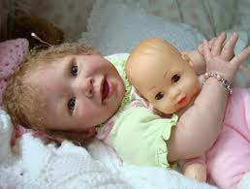
Role Taking: Stage I
Imitation stage: This is Mead’s first stage in the development of role taking; (begins around 1 ½ - 2 years old) at this stage, the child imitates (without understanding) the physical and verbal behavior of a significant other.

Slide 27
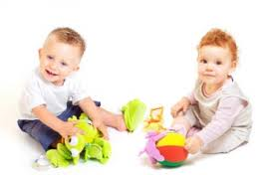
Role Taking: Stage II
Play Stage: Mead’s 2nd stage in the development of role taking; at the age of 3 to 4, a young child can be seen playing at being a parent, police officer, teacher, or astronaut.
This play involves acting and thinking as a child IMAGINES another person would; the stage during which children take on roles of others one at a time

Slide 28
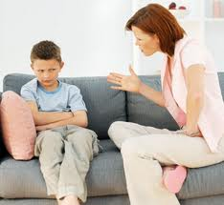
Role Taking: Stage III
Game Stage: Mead’s 3rd stage in the development of role taking; Here children learn to engage in more sophisticated role taking as they become able to consider the roles of several people simultaneously
Children anticipate the actions of others based on social rules

Slide 29
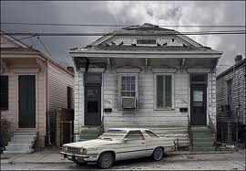
SI: The Generalized Other
The generalized other: An integrated conception of the norms, values, and beliefs of one’s community or society

Slide 30
Me v. I
According to Mead, the first reaction of the self comes from the “I.”
“Me”: the part of the self created through socialization; the “me” accounts for predictability and conformity
“I”: the part of the self that accounts for unlearned, spontaneous acts

Slide 31
Me v. I
“I” is myself as I am…
“ME” is my self as others see me & the me portrayed for others
Genie didn’t have a concept of “me” because she was not socialized to perceive how others saw her, she only had a concept of “I” – she was an egocentric baby with no concept of anything but her own needs

Slide 32
Activity
Assignment
Write a 5-8 verse poem or a 500 word reflective essay regarding the looking-glass self.
How similar are “I” and “Me?”
Why do you present “Me” the way you do? How do you think others see you?
Does your “I” affect your “Me” more than your “Me” affects your “I?”
Who is you?

Slide 33
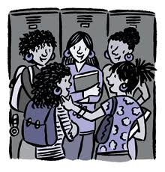
Agents of Socialization
I. The Family
II. School
III. Peer Groups
IV. Mass Media

Slide 34
Agents of Socialization: The Family
The child’s 1st exposure to the world occurs within the family. Within the family, the child learns to:
Think and speak
Internalize norms, beliefs, and values
Form some basic attitudes
Develop a capacity for intimate and personal relationships
Acquire a self-image

Slide 35
Agents of Socialization: School
In school, children are under the care and supervision of adults who are not relatives. For the first time, many of the child’s relationships with other people are impersonal.
Rewards and punishments are based on performance rather than affection. The school creates feelings of loyalty and allegiance to something beyond school.

Slide 36
Agents of Socialization: School
Socialization in schools involves more than just reading, writing, and math…
Underlying the formal goals of school is the hidden curriculum- the informal and unofficial aspects of culture that children are taught in preparation for life.
The hidden curriculum teaches children discipline, order, cooperation, and conformity- characteristics required for success in the adult world of work

Slide 37
Agents of Socialization: Peer Groups
Composed of individuals of roughly the same age and interests
This is the ONLY socialization that is not controlled primarily by adults

Slide 38
Agents of Socialization: Mass Media
Mass media are the means of communication designed to reach the general population (including: tv, radio, newspapers, magazines, movies, books, the Internet, etc.)
The mass media display role models for children to imitate.
They also offer children ideas about the values in their society.
They provide children with images of achievement and success, activity and work, equality and democracy.

