Slide 1
Social Deviance
Part II
Theories

Slide 2
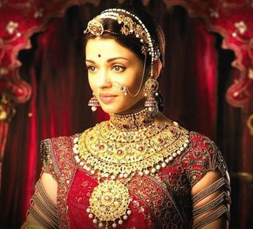
Social Deviance
The concept of deviance is complex because norms vary considerably across groups, times, and places. In other words, what one group may consider acceptable, another may consider deviant.

Slide 3
Differential-Association Theory
Edwin Sutherland coined the phrase differential association to address the issue of how people learn deviance.
The environment plays a major role in deciding which norms people learn to violate. Specifically, people within a particular reference group provide norms of conformity and deviance, and thus heavily influence the way other people look at the world, including how they react.

Slide 4
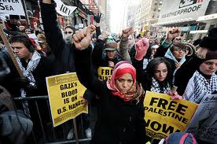
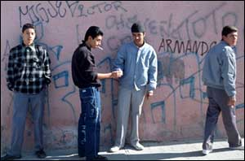

Slide 5
Differential-Association Theory
People also learn their norms from various socializing agents—parents, teachers, ministers, family, friends, co-workers, and the media. In short, people learn criminal behavior, like other behaviors, from their interactions with others, especially in intimate groups

Slide 6
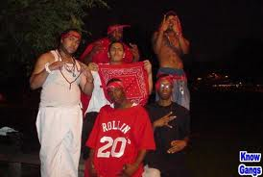
Differential-Association Theory
The differential-association theory applies to many types of deviant behavior.
For example, juvenile gangs provide an environment in which young people learn to become criminals. These gangs define themselves as countercultural and glorify violence, retaliation, and crime as means to achieving social status. Gang members learn to be deviant as they embrace and conform to their gang's norms.

Slide 7
Differential-Association Theory
Differential-association theory has contributed to the field of criminology in its focus on the developmental nature of criminality. People learn deviance from the people with whom they associate.
Critics of the differential-association theory, on the other hand, claim the vagueness of the theory's terminology does not lend itself to social science research methods or empirical validation.

Slide 9
Anomie Theory
Anomie refers to the confusion that arises when social norms conflict or don't even exist.
In the 1960s, Robert Merton used the term to describe the differences between socially accepted goals and the availability of means to achieve those goals.
Merton stressed, for instance, that attaining wealth is a major goal of Americans, but not all Americans possess the means to do this, especially members of minority and disadvantaged groups. Those who find the “road to riches” closed to them experience anomie, because an obstacle has thwarted their pursuit of a socially approved goal. When this happens, these individuals may employ deviant behaviors to attain their goals, retaliate against society, or merely “make a point.”

Slide 10
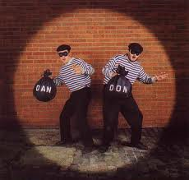

Slide 12
Anomie Theory
The primary contribution of anomie theory is its ability to explain many forms of deviance.
The theory is also sociological in its emphasis on the role of social forces in creating deviance.
On the negative side, anomie theory has been criticized for its generality. Critics note the theory's lack of statements concerning the process of learning deviance, including the internal motivators for deviance. Like differential association theory, anomie theory does not lend itself to precise scientific study.

Slide 13
Deviance
Social Factor
Social Factor
Social Factor
Social Factor

Slide 14
Control Theory
Walter Reckless developed control theory, in which both inner and outer controls work against deviant tendencies. In other words, people may want (at least some of the time) to act in deviant ways, but most do not.
There are various restraints:
Internal (inner) controls, such as conscience, values, integrity, morality, and the desire to be a “good person”
External (outer) controls, such as police, family, friends, and religious authorities.

Slide 19
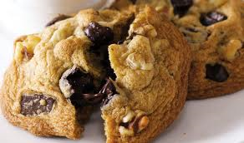
Control Theory
Travis Hirschi noted that these inner and outer restraints form a person's self-control, which prevents acting against social norms.
The key to developing self-control is proper socialization, especially early in childhood. Children who lack this self-control, then, may grow up to commit crimes and other deviant behaviors.

Slide 20
Control Theory
Whereas control theory also suggests that people society labeled as “criminals” are probably members of subordinate groups, critics argue that this oversimplifies the situation.
Ex: wealthy and powerful businesspeople, politicians, and others who commit crimes. Critics also argue that conflict theory does little to explain the causes of deviance.
Proponents counter, however, by asserting that the theory does not attempt to delve into etiologies. Instead, the theory does what it claims to do: It discusses the relationships between socialization, social controls, and behavior.

Slide 21
Labeling Theory
A type of symbolic interaction, labeling theory concerns the meanings people derive from one another's labels, symbols, actions, and reactions.
This theory holds that behaviors are deviant only when society labels them as deviant. As such, conforming members of society, who interpret certain behaviors as deviant and then attach this label to individuals, determine the distinction between deviance and non-deviance. Labeling theory questions who applies what label to whom, why they do this, and what happens as a result of this labeling.

Slide 24
Labeling Theory
Powerful individuals within society—politicians, judges, police officers, medical doctors, and so forth—typically impose the most significant labels.
Labeled persons may include drug addicts, alcoholics, criminals, delinquents, prostitutes, sex offenders, retarded people, and psychiatric patients, to mention a few.
The consequences of being labeled as deviant can be far-reaching. Social research indicates that those who have negative labels usually have lower self-images, are more likely to reject themselves, and may even act more deviantly as a result of the label.
Unfortunately, people who accept the labeling of others—be it correct or incorrect—have a difficult time changing their opinions of the labeled person, even in light of evidence to the contrary

Slide 26
Labeling Theory – Saints & Roughnecks
William Chambliss in 1973 conducted a classic study into the effects of labeling. His two groups of white, male, high-school students were both frequently involved in delinquent acts of theft, vandalism, drinking, and truancy. The police never arrested the members of one group, which Chambliss labeled the “Saints,” but the police did have frequent run-ins with members of the other group, which he labeled the “Roughnecks.” The boys in the Saints came from respectable families, had good reputations and grades in school, and were careful not to get caught when breaking the law. By being polite, cordial, and apologetic whenever confronted by the police, the Saints escaped labeling themselves as “deviants.”

Slide 27
Labeling Theory – Saints & Roughnecks
In contrast, the Roughnecks came from families of lower socioeconomic status, had poor reputations and grades in school, and were not careful about being caught when breaking the law. By being hostile and insolent whenever confronted by the police, the Roughnecks were easily labeled by others and themselves as “deviants.” In other words, while both groups committed crimes, the Saints were perceived to be “good” because of their polite behavior (which was attributed to their upper-class backgrounds) and the Roughnecks were seen as “bad” because of their insolent behavior (which was attributed to their lower-class backgrounds). As a result, the police always took action against the Roughnecks, but never against the Saints.

Slide 28
Labeling Theory
Proponents of labeling theory support the theory's emphasis on the role that the attitudes and reactions of others, not deviant acts per se, have on the development of deviance.
Critics of labeling theory indicate that the theory only applies to a small number of deviants, because such people are actually caught and labeled as deviants.
Critics also argue that the concepts in the theory are unclear and thus difficult to test scientifically.

