Slide 1
The Settlement of New England

Slide 2
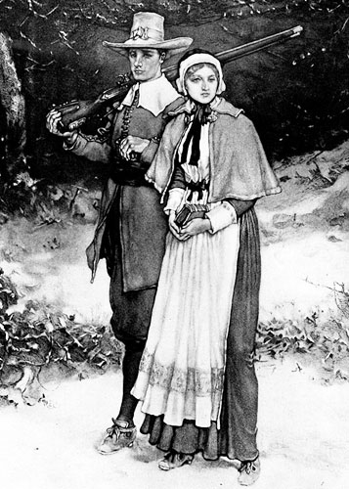
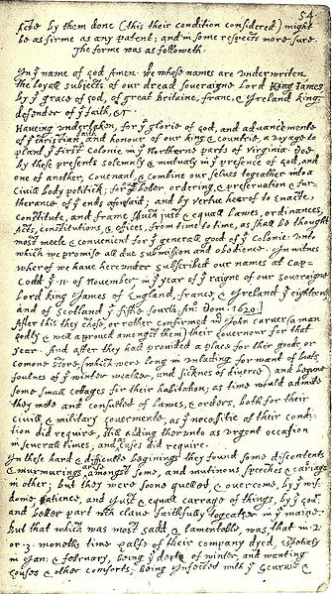
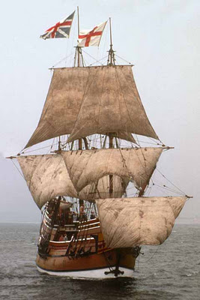
Colony | Founder | Reason Founded | Other notes
Massachusetts | Plymouth- William Bradford | religious freedom | Separatist- separate from Church of England. Flee to Holland then in 1620 decided to leave. Founded Plymouth colony. (Pilgrims). Originally set sail for VA but experienced hardships: blown off course, food ran out, much illness, 1 death Before landed all settlers signed Mayflower Compact in which all colonist will obey and abide by government laws. ( Democratic Form of government) Planned on staying; built shelter but plagued killed half of settler in first 6 months.

Slide 3
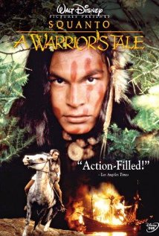
Squanto
A friendly Native American took pity on the settlers and instructed them in farming corn and how to locate good fishing grounds
Squanto had once been captured by English traders and had lived in England, so he spoke English
Squanto also negotiated a peace agreement between the settlers and the local tribes

Slide 4
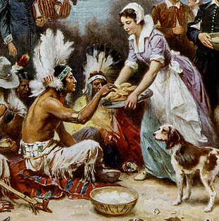
First Thanksgiving?
The Pilgrims celebrated their one-year anniversary of survival and their alliance with the local Natives by holding a “Thanksgiving” festival, sometime in autumn 1621
Virginia settlers, however, had begun recognizing a “thanksgiving” holiday as early as 1619, and Spanish settlers in Florida had celebrated as early as the 1540s

Slide 5
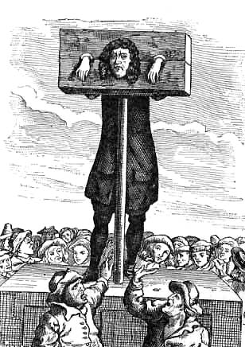
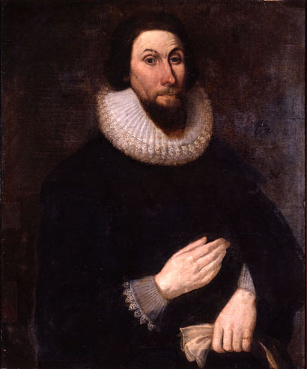
Colony | Founder | Reason Founded | Other notes
Massachusetts | MA Bay Company- John Winthrop | religious freedom | Led 900 settlers to colony. Puritans- wanted to reform church. “ A City Upon a Hill” Religiously strict; only white men with property could vote, owned stock in MA Bay CO. & paid taxes. Church attendance was required by law; taxes were used to support the church; gambling, blasphemy, adultery, and drunkenness were all severely punished Heretics (those who disagreed with the church) were banished from the colony

Slide 6
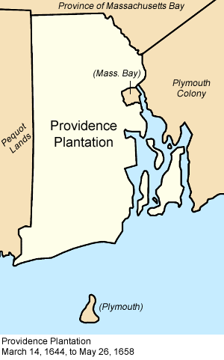
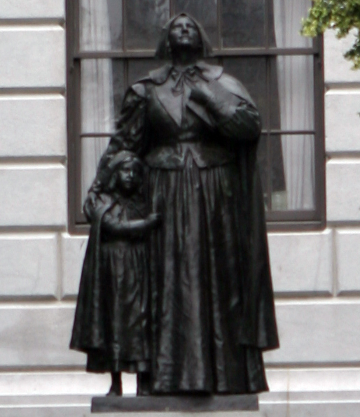
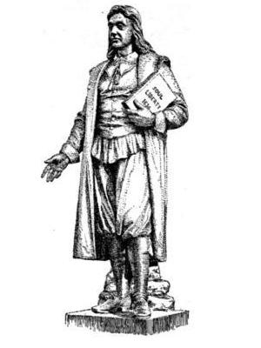
Colony | Founder | Reason | Information
Rhode Island | Roger Williams & Anne Hutchinson | religious freedom | Wanted all to worship freely. Banned from colony due to heresy. Williams- Believed Puritan church had to much power, gov’t & church should be separate, and gov’t should promote peace but not promote one particular religion. (Providence) Hutchinson- believed Claimed that God spoke to her and revealed to her which ministers were correct and which wrong (founded town of Portsmouth). Puritans believed that God only spoke through the Bible; Hutchinson was convicted of heresy and banished

Slide 7
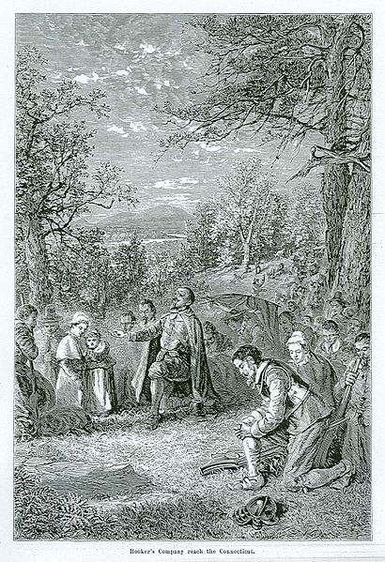
Colony | Founder | Reason | Information
Connecticut | Thomas Hooker- Puritan Minister | dissatisfied with laws in MA. | Hooker and his followers were frustrated with their inability to find good land in Massachusetts and by the requirement that one must hold stock in the Bay Company in order to vote Upset with voting participation in MA. Believed all men should have the right to vote. Fundamental Orders of Connecticut-first written constitution in the American Colonies. (Allowed all white men to vote)

Slide 8
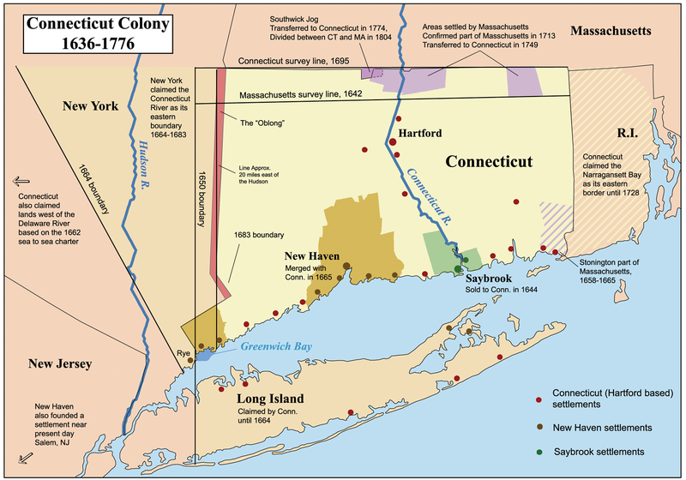
Colony | Founder | Reason | Information
Connecticut | Thomas Hooker | dissatisfied with laws in MA. | Upset with voting participation in MA. Believed all men should have the right to vote. Fundamental Orders of Connecticut-first written constitution in the American Colonies . All men allowed to vote for Governor and the General Court

Slide 9
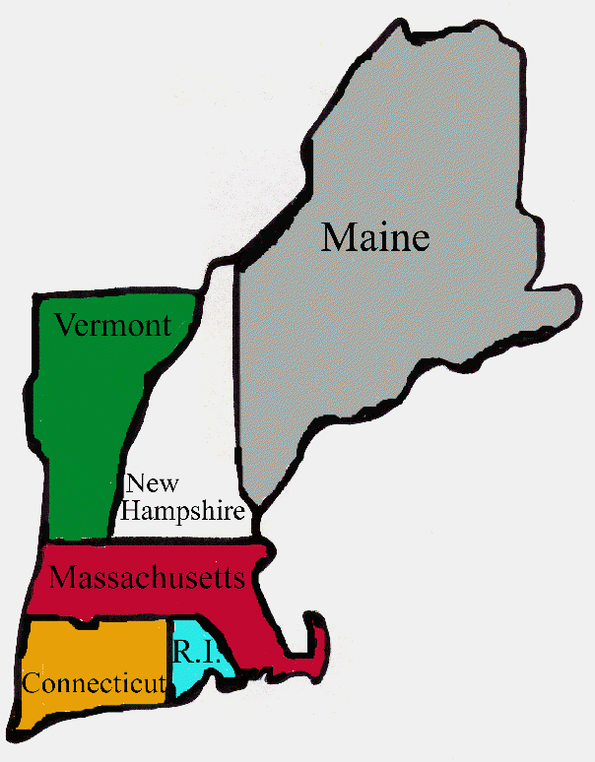
Colony | Founder | Reason | Information
New Hampshire & Maine | settlers from MA | Economic opportunities | founding primarily for farming; In 1679, broke away from Massachusetts Maine, despite having a distinct population, remained part of Massachusetts until 1820

Slide 10
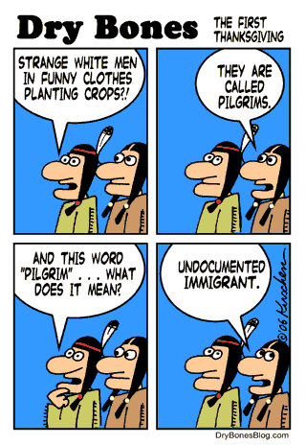
Tensions Build
Generally, New England native tribes and their white neighbors lived together peacefully, engaging in trade
As time passed, however, white settlers increasingly encroached on native lands and the colonial governments began to demand that natives obey their laws

Slide 11
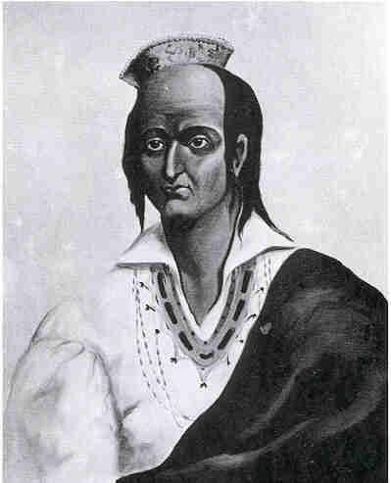
King Philip’s War
In 1675, Plymouth colony arrested, tried, and executed 3 Wampanoags for murder, leading to an attack by the natives
This led to a brutal war between whites and natives, known as King Philip’s War (King Philip was the name given by settlers to the Indian chief Metacomet)
By 1678, New England’s native population had been defeated and driven west, leaving the region in the hands of the settlers

