Slide 6
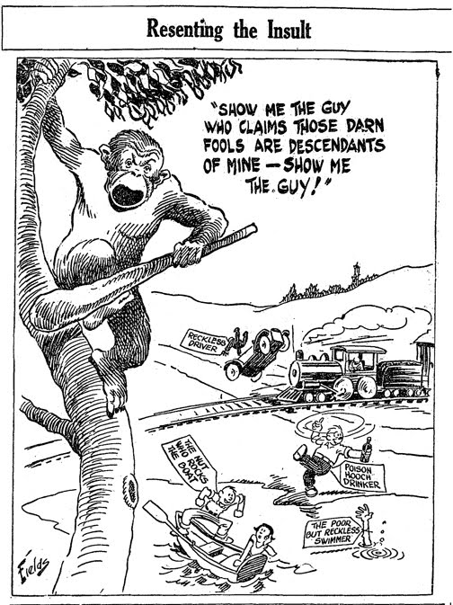
Tennessee’s Butler Act
Passed in 1925
The state of Tennessee banned all schools, including universities, from teaching human evolution and required the teaching of creationism
Punishment for breaking the law was a fine of $100 - $500 per offense

Slide 7

ACLU
The American Civil Liberties Union had been founded in 1920 "to defend and preserve the individual rights and liberties guaranteed to every person in this country by the Constitution and laws of the United States.“
In 1925, the ACLU sought out a teacher who would be willing to intentionally violate the Butler Act in order to test the constitutionality of the Act

Slide 8
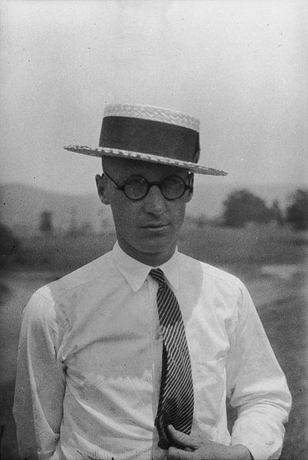
John Scopes
1900 – 1970
Tennessee high school teacher who agreed to be the ACLU’s test case
Used the state-approved biology textbook (which contained a chapter on evolution) to teach the subject, thereby breaking the law and triggering the Scopes Monkey Trial
Encouraged his own students to testify against him!

Slide 9
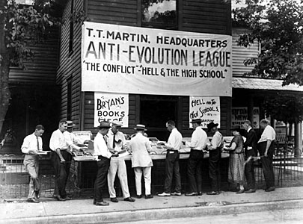
Scopes Monkey Trial
Tried in July 1925
Case drew high-profile coverage from all over the world as science faced off against religious fundamentalism
Defense would argue both that evolution was not necessarily in conflict with creationism and that the law was unconstitutional on the grounds that it was designed to benefit the beliefs of a specific religious group

Slide 10
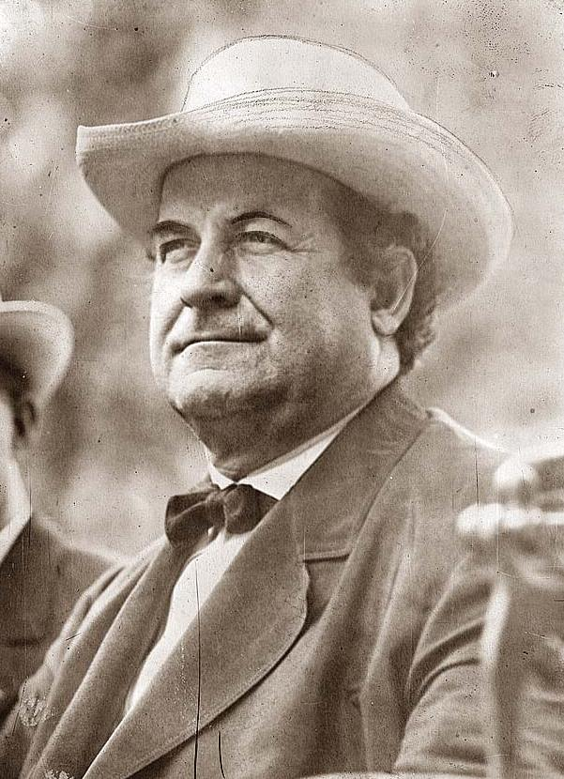
William Jennings Bryan
1860 – 1925
3-time candidate for president and former Secretary of State
Served as a special prosecutor for the state during the Scopes trial and even testified as an “expert witness” (his testimony was largely damaging to his own case and was struck from the record)
Died 5 days after the trial ended

Slide 11
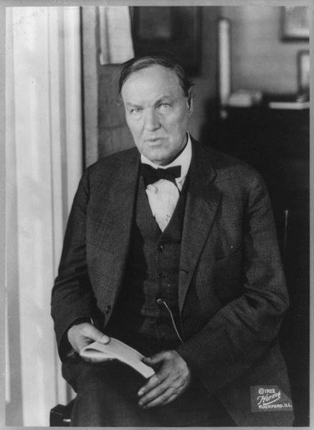
Clarence Darrow
1857 – 1938
Celebrity criminal lawyer, fresh off a nationally covered murder case in Chicago where he had saved the lives of his teenage clients
Brought in as a “hired gun” by the ACLU both for his skill as a lawyer and for the publicity his reputation would bring

