Slide 1
FDR and the First 100 Days

Slide 2
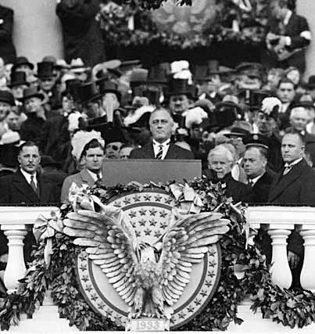
When Roosevelt was inaugurated as president, unemployment was at an all-time high
In his inaugural address, FDR inspired hope, declaring “the only thing we have to fear is fear itself”
“Let me assert my firm belief that the only thing we have to fear is fear itself; nameless, unreasoning, unjustified terror which paralyzes needed efforts to convert retreat into advance.”

Slide 3
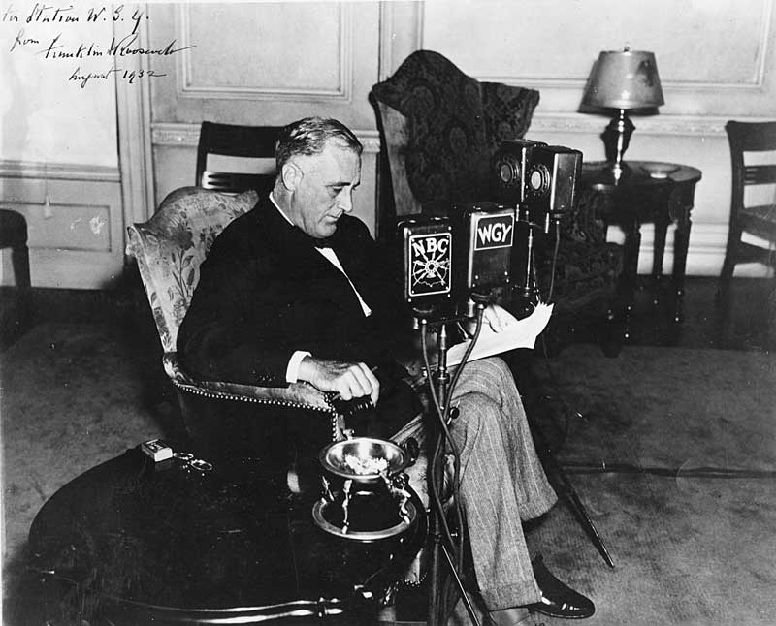
A New Deal Fights the Depression
The New Deal → Focus on 3r’s:
Relief (Relief checks and job programs to lower unemployment)
Recovery(Programs to stimulate agriculture, industry, and the economy to end the depression)
Reform(Programs to correct problems in the economy and prevent future depressions)
Deficit Spending → proposed by economist John Maynard Keynes; in times of recession, government should spend borrowed money to help stimulate growth and then raise taxes later to pay back the money

Slide 4
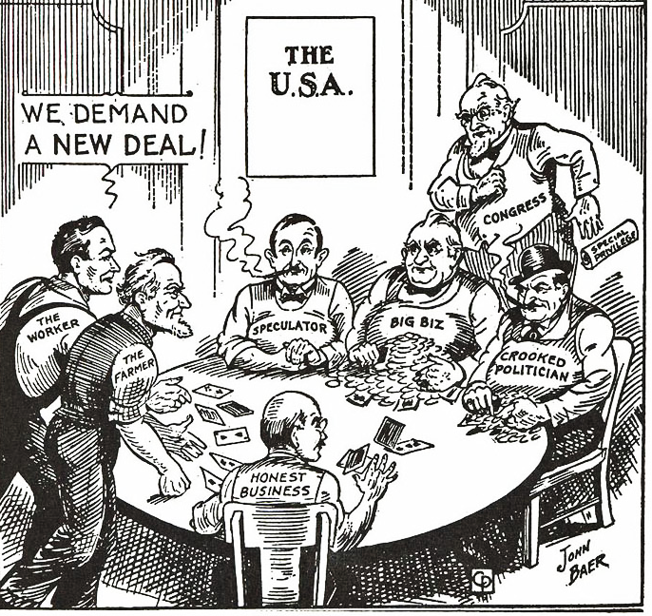
A New Deal Fights the Depression
The First 100 Days → a period of intense activity at the beginning of FDR’s first term
Congress passed 15 major pieces of legislation
Expanded the federal government’s role in the economy
Fireside Chats → FDR used weekly radio addresses to update and encourage the American people on the progress the country was making

Slide 5
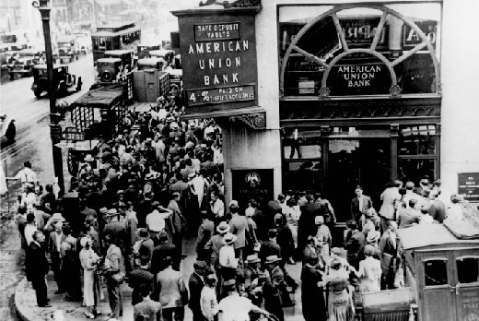
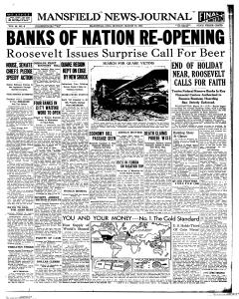
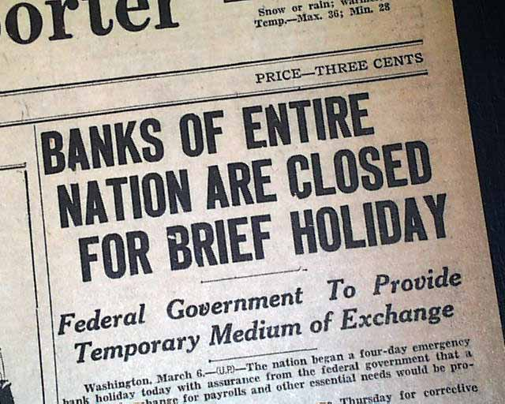
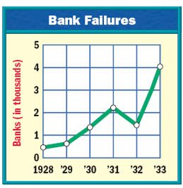
Emergency Banking Relief Act
FDR’s first action was to address the bank crisis
Upon assuming office, FDR declared a federal banking holiday and closed all banks and called Congress into a special session
Both houses of Congress passed the Emergency Banking Relief Act in a single afternoon
The act called for all banks to be assessed for credit-worthiness by the US government and banks found to be stable enough were issued special federal licenses to operate

Slide 6
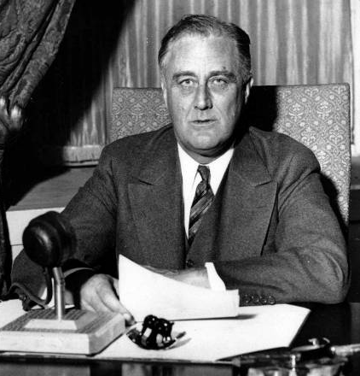
Fireside Chats
Roosevelt then went on the radio and assured Americans that it was safe to put their money back in these newly licensed banks
Americans believed him and stopped withdrawing their money from the banking system and began resuming deposits
Throughout his presidency, FDR would keep America informed of his intentions and progress through these radio-broadcast “fireside chats”

Slide 7
Fireside Chat on the Banking Crisis
Read the selected portions of FDR’s Fireside Chat from March 1933.
Respond to the following as you read:

Slide 8
New Deal Programs Research Assignment
In groups, complete the chart …..

Slide 9
A New Deal Fights the Depression
Federal Program | What was its immediate purpose? | What was its long-term goal?
Business Assistance and Reform
Securities Act 1933 | Required all securities sold in the US to be registered with the US government Required companies which sold stocks and bonds to provide complete and truthful information to investors | To restore public confidence in stock market
Securities & Exchange Commission 1934 | Government agency which enforces the Securities Act Responsible for supervising companies in US which deal in securities (stocks, bonds, and other financial investments) | To restore public confidence in stock market

Slide 10
A New Deal Fights the Depression
Federal Program | What was its immediate purpose? | What was its long-term goal?
Business Assistance and Reform
Emergency Banking and Relief Act 1933 | Set a temporary bank holiday; authorized the Treasury Department to inspect and close bad banks; government loaned money to banks in need | To restore public confidence in banks
Glass-Steagall Banking Act of 1933 | Established the FDIC (insured consumer deposits against bank failures) | To restore public confidence in banks

Slide 11
Federal Program | What was its immediate purpose? | What was its long-term goal?
Business Assistance and Reform
Civilian Conservation Corps 1933 | Government agency which offered work to unemployed men between 17 and 25 in the forestry service Workers planted trees, fought forest fires, and built drinking water reservoirs Workers lived in special camps and earned $30 per month Over 3 million men worked for the CCC over its 9 years | Reduce unemployment rate
Federal Emergency Relief Administration 1933 | Provided work for over 20 million by giving over $3 billion to state and local governments so they could create jobs for unskilled labor Many of these jobs were in manufacturing consumer goods for the needy – canning fruits & vegetables, making mattresses and bedding, distributing surplus food to the hungry Replaced by the WPA in 1935 | Provide direct relief to states for the unemployed

Slide 12
Federal Program | What was its immediate purpose? | What was its long-term goal?
Business Assistance and Reform
Public Works Administration 1933 | Created by the NIRA Government agency which created jobs for skilled workers through large-scale public works projects, such as the construction of dams, bridges, and highways Spent over $6 billion | Provide relief through work projects
CWA 1933 | Part of FERA; Provided short-term work to 4 million Built sewers and other sanitation systems, roads, airports, and over 40,000 schools Paid salary of more than 50,000 school teachers Spent over $1 billion in just over 5 months | Provide relief through work projects

Slide 13
Federal Program | What was its immediate purpose? | What was its long-term goal?
Farm Relief/Rural Development
Agricultural Adjustment Act (AAA) 1933 | Provided government loans to farmers Paid farmers to not grow crops in order to reduce supply and push up crop prices Program saved American farmers from ruin, but angered consumers because it increased the price of food | To raise crop prices (and, thus, farm income)
Farmers Credit Administration 1933 | Farmers’ version of the HOLC Helped farmers refinance the mortgages on their farms Saved thousands of family farms | Help farmers recovery from foreclosures
Homeowners Loan Corporation 1933 | Created to save homeowners from eviction US government bought mortgages from banks and then restructured them with lower interest rates and longer terms About 10% of home owners in the US had mortgages with the HOLC Still, thousands could not make even the adjusted payments and the HOLC foreclosed on many homes | Help all Americans recovery who could not meet mortgage payments

Slide 14
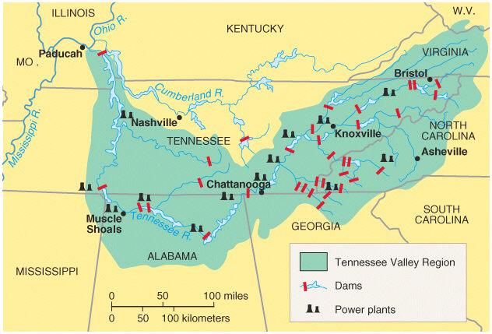
Federal Program | What was its immediate purpose? | What was its long-term goal?
Business Assistance and Reform
Tennessee Valley Authority (TVA) 1933 | Part of FERA; Provided short-term work to 4 million Built sewers and other sanitation systems, roads, airports, and over 40,000 schools Spent over $1 billion in just over 5 months | To create prosperity and bring electricity in the impoverished Tennessee Valley region

Slide 15
Federal Securities Act | Required corporations to provide complete information on all stock offerings | To restore public confidence in the stock market
National Recovery Act (NIRA) 1933 | Mission was to stabilize prices for manufactured goods and prevent any more businesses from failing Helped create codes of fair competition and reductions in competition Struck down as unconstitutional by the Supreme Court in case of Schechter v. US in 1935 Set prices; established labor standards | To ensure fair business practices and to promote industrial growth

Slide 16
2nd New Deal
Federal Program | What was its immediate purpose? | What was its long-term goal?
Employment Projects
Social Security Administration 1935 | Provides retirement income for all workers once they reach age 65; also provides payments to needy children and people with permanent disabilities Also included the first form of unemployment insurance All of this is paid for through a payroll tax which every worker in America pays | Programs to correct problems in the economy and prevent future depressions
National Labor Board ( Wagner Act) 1935 | Created by the National Labor Relations Act (also called the Wagner Act) Designed to monitor unfair management practices, monitor labor unions, and act as an arbitrator between management and unions | Programs to stimulate industry and the economy to end the depression

Slide 17
Federal Program |  | What was its immediate purpose? | What was its long-term goal?
Employment Projects
Works Progress Administration 1935 | Create jobs to 8 million workers; mostly unskilled. Built airports, roads, buildings, made garments for the needy. Employed many professionals who painted murals on school walls, wrote guides to cities, collected slave narratives, and performed in theater troupes around the country. | 1938 Raised minimum wage to $.40/hour Set maximum number of work hours at 44 hours/week Required payment of overtime wages Banned child labor for those under 16 years of age | Reduce Unemployment rate
National Youth Administration 1935 | Provide recreation, counseling, education, and jobs for young people. Provided student aid to high school, college, and graduate students Graduate unable to find jobs or students who dropped out, provided part-time jobs working on highways and parks. | 1937 Created the US Housing Authority (USHA) Subsidized loans to builders who were willing to tear down old tenements and build large tracts of low-cost housing to help the poor First public housing (“projects”) effort in the US | Decrease Homeless rate and provide loans for building and repairing homes

Slide 18
Federal Program |  | What was its immediate purpose? | What was its long-term goal?
Employment Projects
Fair Labor Standard Act 1938 | Raised minimum wage to $.40/hour Set maximum number of work hours at 44 hours/week Required payment of overtime wages Banned child labor for those under 16 years of age | 1938 Raised minimum wage to $.40/hour Set maximum number of work hours at 44 hours/week Required payment of overtime wages Banned child labor for those under 16 years of age | Stimulate industry, and the economy to end the depression
National Housing Act 1937 | Created the US Housing Authority (USHA) Subsidized loans to builders who were willing to tear down old tenements and build large tracts of low-cost housing to help the poor First public housing (“projects”) effort in the US | 1937 Created the US Housing Authority (USHA) Subsidized loans to builders who were willing to tear down old tenements and build large tracts of low-cost housing to help the poor First public housing (“projects”) effort in the US | Decrease Homeless rate and provide loans for building and repairing homes
Farm Securities Administration 1937 | The programs of the AAA had helped farmers who owned the land they worked, but had hurt tenant farmers The FSA was created to loan money to tenant farmers so that they could buy their own farms Loaned over $1 billion | The programs of the AAA had helped farmers who owned the land they worked, but had hurt tenant farmers 1937: The FSA was created to loan money to tenant farmers so that they could buy their own farms Loaned over $1 billion | Stimulate agriculture and the economy to end the depression

Slide 19
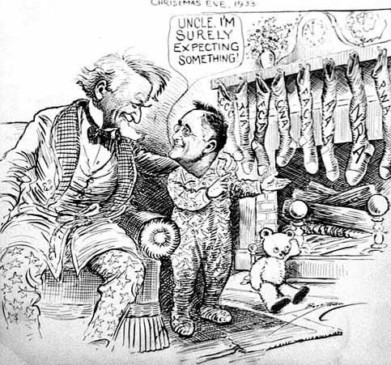
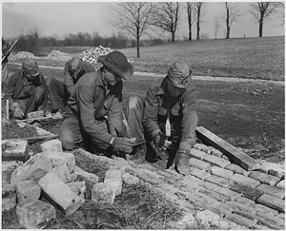
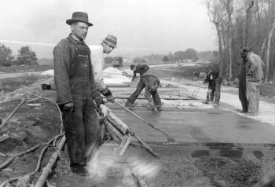
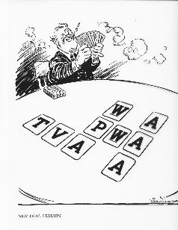
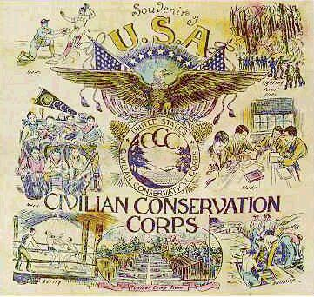

Slide 20
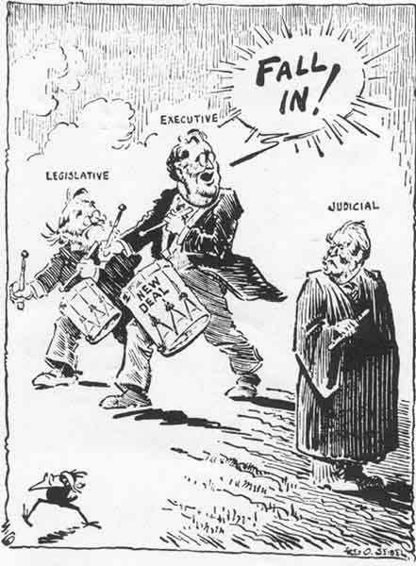
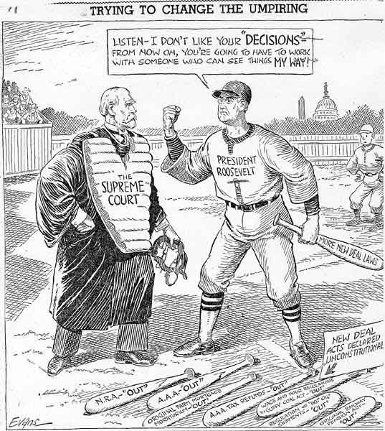

Slide 21
Huey Long → Louisiana Senator who turned against the New Deal and proposed more radical social programs including a guaranteed income (Share-Our-Wealth)
American Liberty League → Conservative group that believed the New Deal violated rights of individuals and property
Father Charles Coughlin → Catholic priest who favored a guaranteed income and government takeover of the banks
The Supreme Court → The Court began to strike down parts of the New Deal as unconstitutional (NIRA, AAA)
Critics of the New Deal

Slide 23
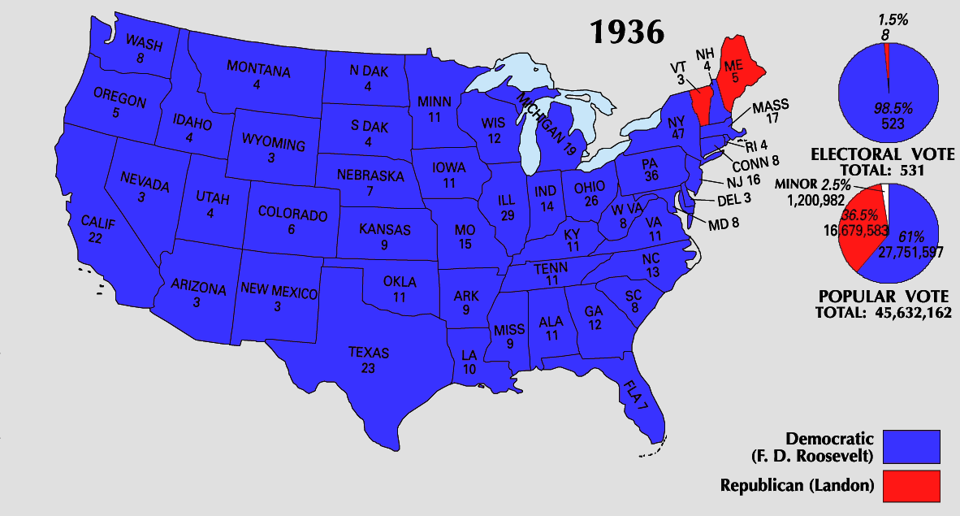

Slide 24
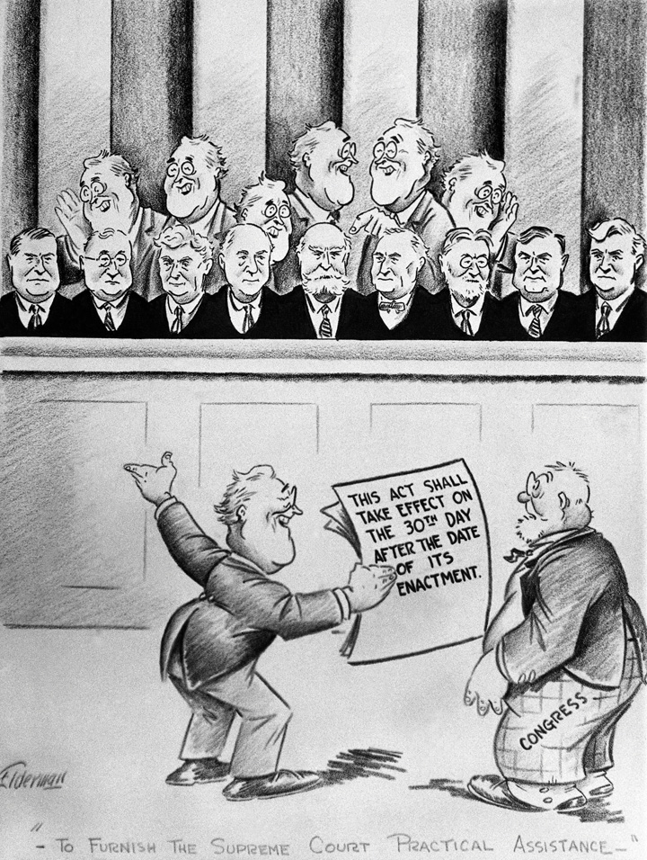
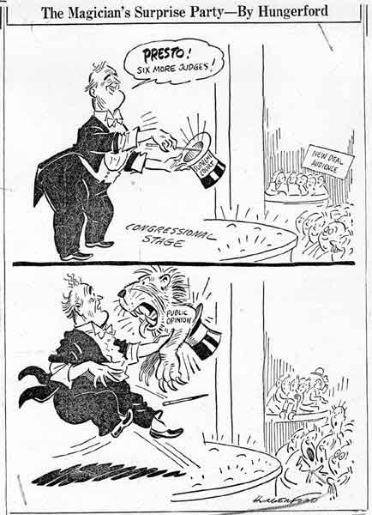
FDR’s “Court-Packing” Scheme
The Supreme Court began overturning New Deal Programs as unconstitutional. | → | FDR was afraid the New Deal would be undone; he asked Congress to pass a Court reform bill allowing him to appoint 6 new justices (court-packing)
For the first time, FDR met opposition from Congress who accused him of violating separation of powers. | → | In 1937, an elderly justice retired and FDR appointed a New Deal supporter (FDR got his way without packing the Court)

Slide 25
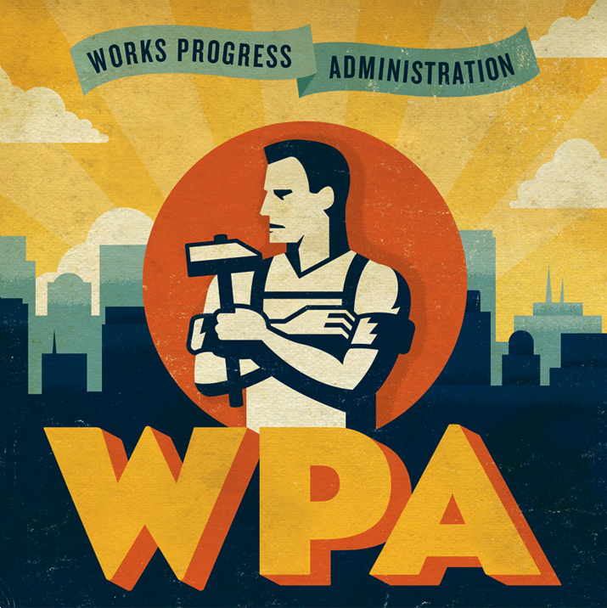
The Second New Deal Takes Hold
Group | What problems did each group face during the Depression? | What laws were passed and agencies established to deal with these problems?
Students, teachers, writers, artists, and all other workers | Unemployment; poverty; hopelessness; loss of dignity | Works Progress Administration (WPA) → built railroads, roads, buildings and sewing clubs for women National Labor Relations Board (Wagner Act) → protected the rights of workers to join unions Fair Labor Standards Act → established a minimum wage

Slide 26
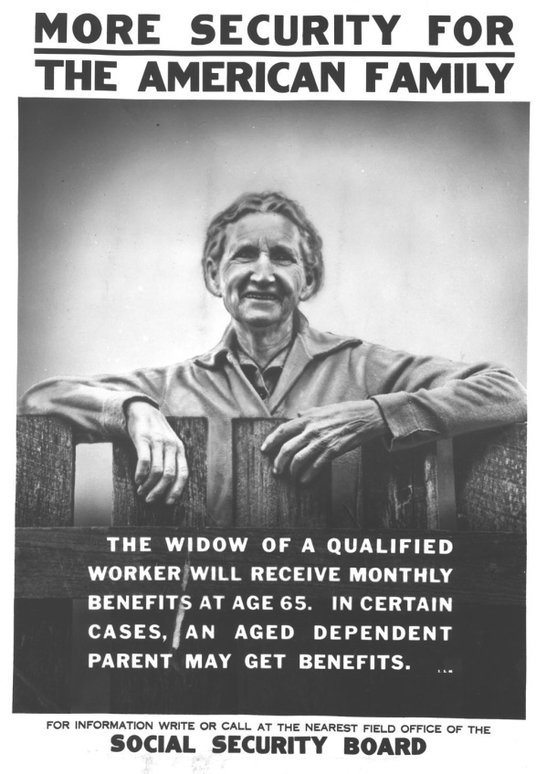
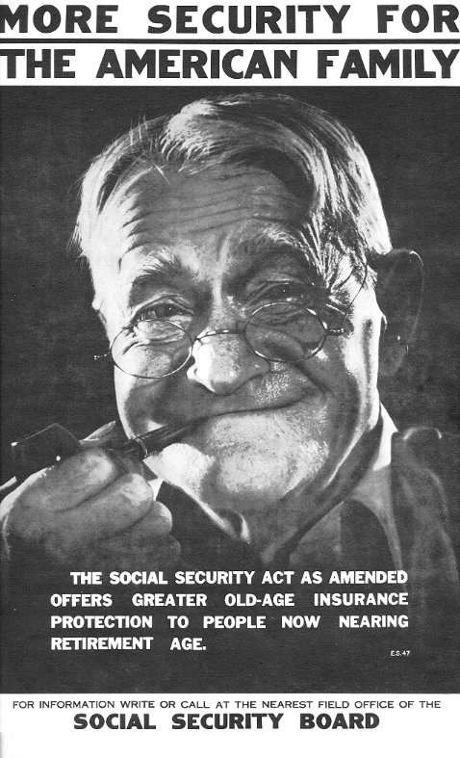
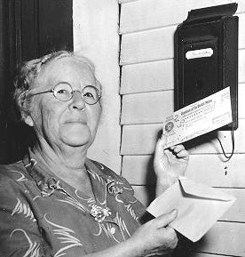
The Second New Deal Takes Hold
Group | What problems did each group face during the Depression? | What laws were passed and agencies established to deal with these problems?
Retired workers, the disabled, the elderly, and dependent mothers and children. | Poverty, hopelessness, loss of dignity | Social Security Act → established old-age insurance at 65; unemployment compensation system; and aid to families with children and the disabled
On January 31, 1940, the first monthly retirement check was issued to Ida May Fuller of Ludlow, Vermont, in the amount of $22.54.

Slide 27
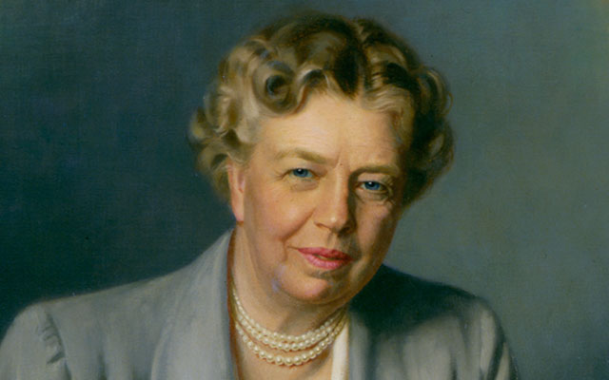
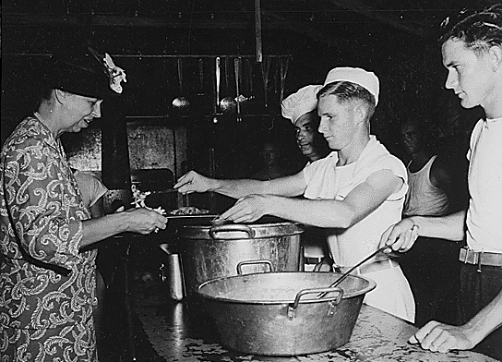
The Second New Deal Takes Hold
Eleanor Roosevelt’s Role in the New Deal
Traveled the country to observe social conditions Helped shape New Deal policies (integration) Prodded her husband to appoint women to government positions (Frances Perkins first woman in the Cabinet) Great advocate for the poor, women, and minorities

Slide 28
